Slide 1
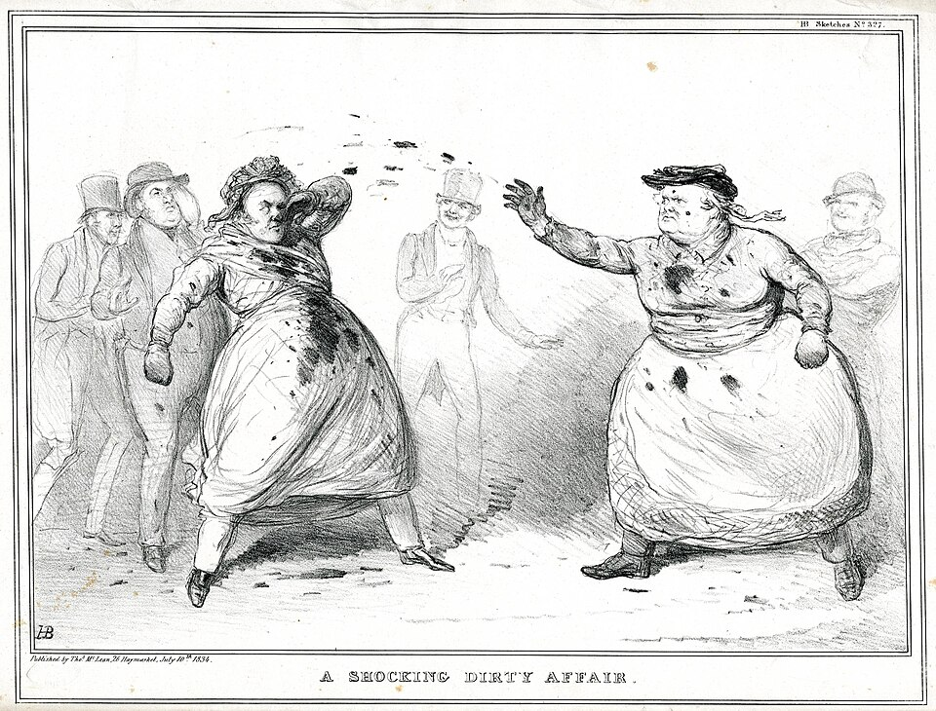
The worst of ‘Times’
Dr Matthew Stephens
Applied History Fellow
Institute of Historical Research
BAVS Conference 2026
Dirty tricks in the mid-century illustrated press
Notes:
Just a brief explanation of this picture, entitled ‘A Shocking Dirty Affair’. It shows: Two men dressed as women throwing mud at each other, with four others watching from behind. The mudslingers caricatured are politicians Edward John Littleton on the left, and on the right, Daniel O’Connell , the acknowledged political leader of Ireland’s Catholic majority in first half of the nineteenth century. This image is dated 10 July 1834 – so earlier than I’m focusing on for this talk, but still an evocative image with which to introduce the theme of playing dirty.

Slide 2
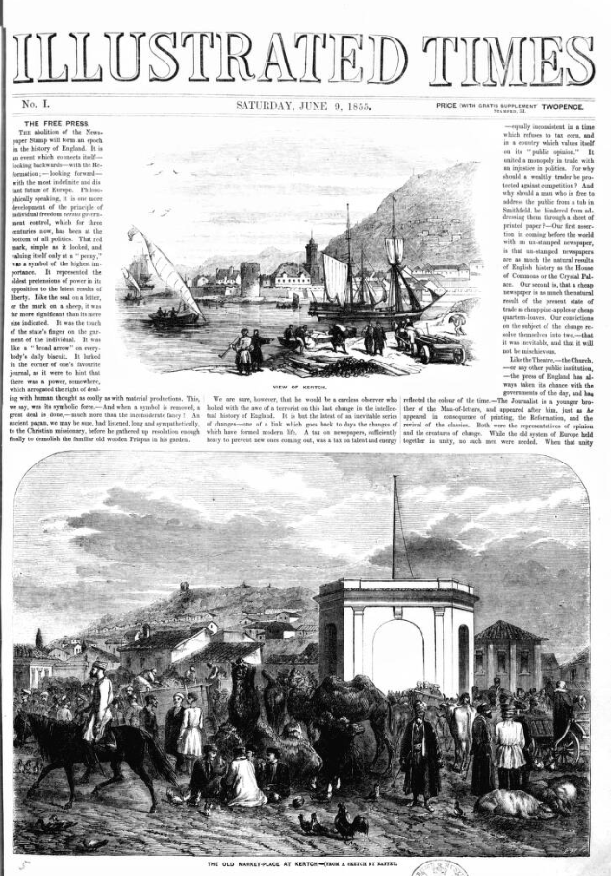
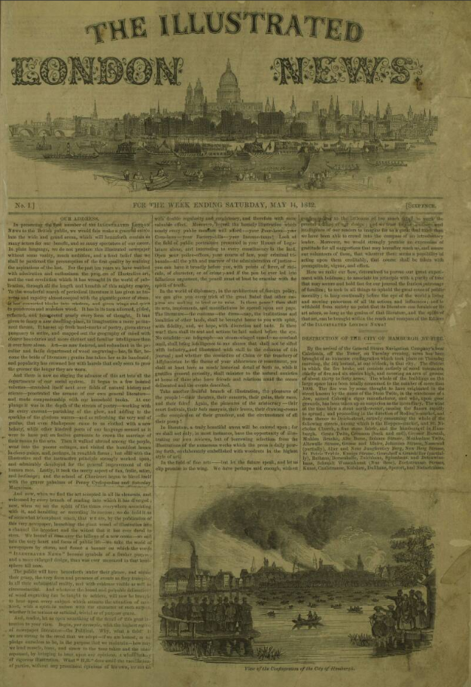
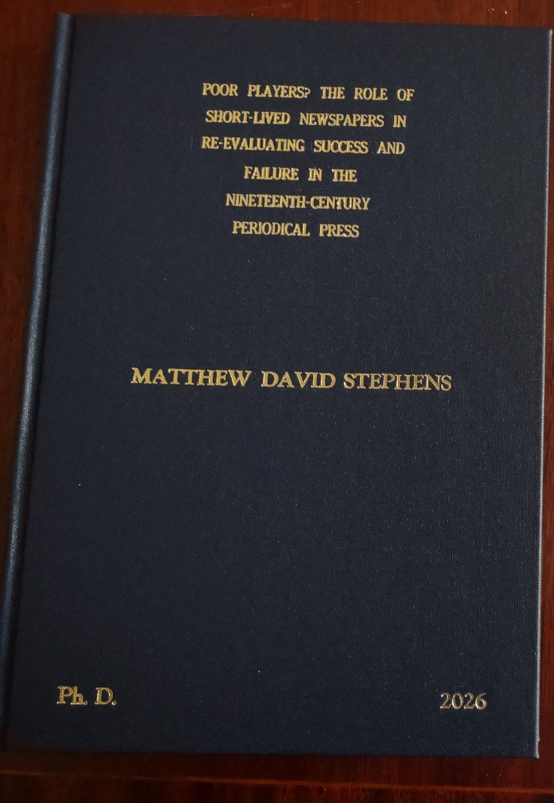
Questions
What were the alleged ‘dirty tricks’ practised against the Illustrated Times?
What evidence remains to support or refute those allegations?
What does this episode reveal about the nature of the newspaper business (and broader culture) in the mid nineteenth-century?
Notes:
I’ve derived this from work done for my PhD thesis – I’m ridiculously proud of it, hence getting it printed and bound in the traditional way. As part of my study of short-lived newspapers, I analysed the motivating factors behind why newspaper proprietors launched new titles into what was generally acknowledged as a very risky business; and I found occasions where proprietors aimed at damaging rivals by whom they felt affronted. [CLICK] The launch of the Illustrated Times in 1855 was primarily motivated by the opportunity provided by the repeal of the newspaper stamp tax to offer a cheaper rival to the established Illustrated London News, [CLICK] which had been established for thirteen years and was the first lasting illustrated newspaper in the world. Having enjoyed a virtual monopoly for over a decade, the proprietor of the ILN, Herbert Ingram, was not pleased at this upstart muscling in and he took a number of actions intended to impact negatively on the newer paper. As I shall explore, there were allegations of some very sharp practice. So, the questions I shall be addressing are these: [CLICK] What were those ‘dirty tricks’ alleged to have been practiced against the Illustrated Times? [CLICK] What evidence is there to support this? [CLICK] And, more broadly, what does this episode tell us about the historical newspaper business and the people who were involved in it?

Slide 3
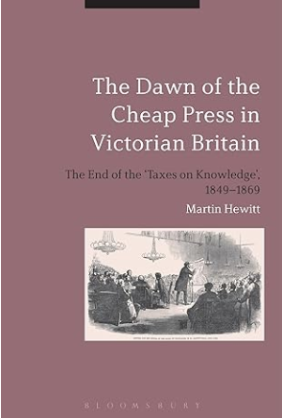
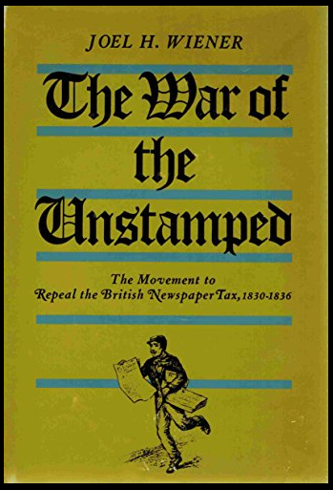
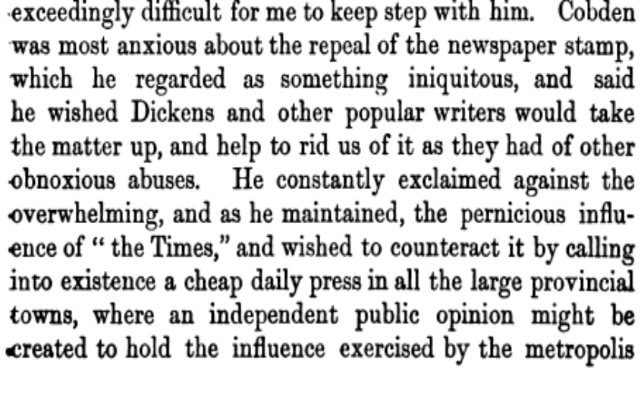
Repeal
Newspaper taxes– earlier campaigns in 1830s.
Association for the Promotion of the Repeal of the Taxes on Knowledge (APRTOK) formed 1849.
Cobden and radicals’ desire to challenge The Times
Not all newspapers in favour of change – pressure to retain monopoly positions
Parliament and the bill for repeal (1855)
Notes:
As Joel Wiener’s work examines in great detail, the campaigns of the 1830s that led to the reduction of the Stamp tax from 4d to one penny in 1836 have tended to capture the imagination, given that they were part of a broader reform movement and also an early example of organised working class resistance – including direct action – to Government oppression. By contrast, the later campaign [CLICK] formalised in 1849, was more measured, more gradual and ultimately more effective in achieving repeal of all taxes on the press by 1861. Strong feelings were in evidence, though. Henry Vizetelly notes how the Manchester Radical Richard Cobden [CLICK] wanted to develop a cheap press to counteract the ‘pernicious influence’ of the Times. [CLICKx2] The Times itself, like a number of established newspapers with a secure business under the taxed model, were naturally resistant to any challenge to the status quo. There is no better analysis of this period in press history than [CLICK] Martin Hewitt’s work and I am not going to presume to summarise it now. The key point is that, [CLICK] by 1855, the debate was largely won and the Parliamentary Act repealing the Stamp tax was widely anticipated to take effect in early June of that year.

Slide 4
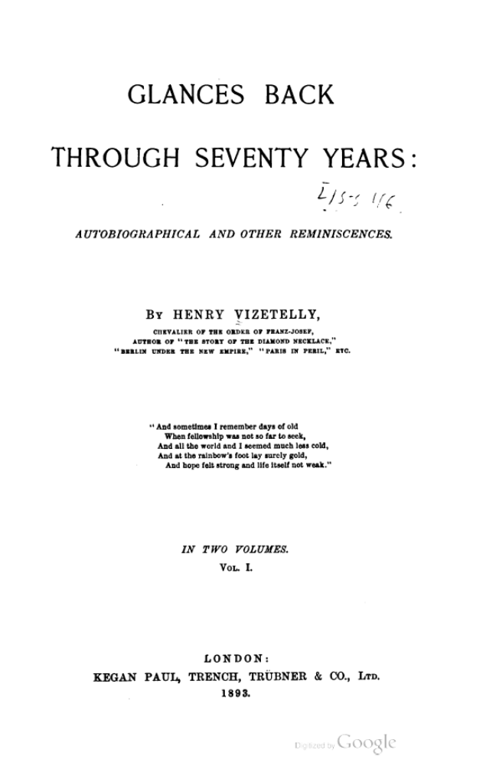
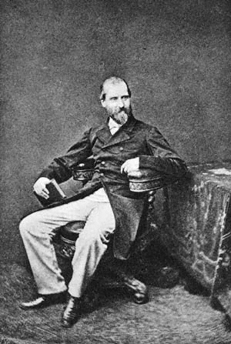
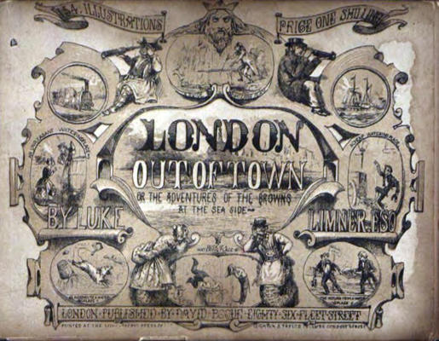
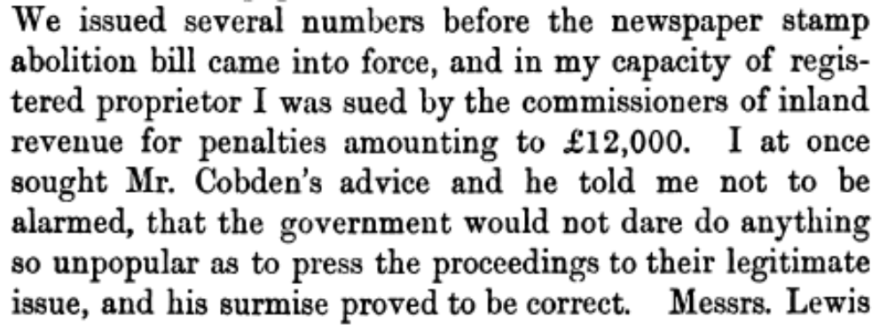
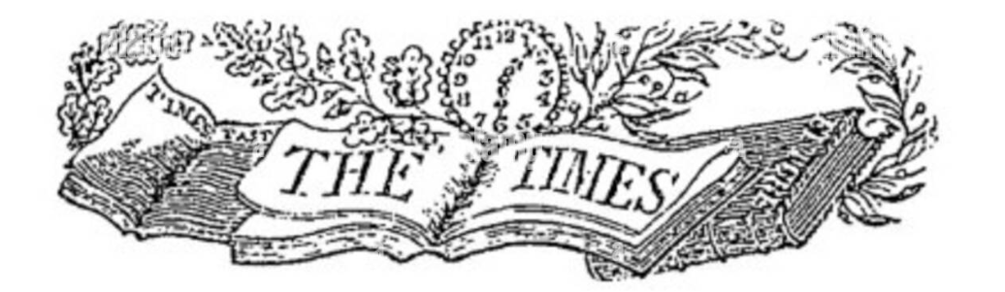
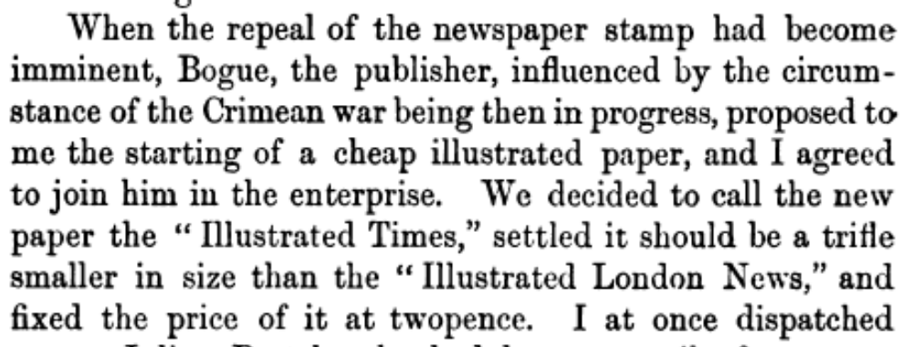
Planning
Notes:
In his memoirs, Henry Vizetelly [CLICK] describes his recollections of plans for launching a new illustrated paper, to be sold at twopence – one-third of the price of the Illustrated London News. The idea apparently came from publisher David Bogue – [CLICK] I could find no image of him, so here is a title page of another of his publications. The time was ripe for two reasons, [CLICK] as this extract makes clear. Firstly, as noted already, the imminent repeal of the tax; and secondly, the Crimean War. (Wars were always good news for newspapers). I’m sure it was no coincidence that they adapted the name of [CLICK] probably the most recognisable journal in print (then and now)! Association with the cachet of the well-established daily was a common tactic – many, many newspapers used this temporal noun as part of their titles – such as Evening Times, Weekly Times, Little Times and many more. The forthcoming new paper was trailed widely and with no expense spared. Everything was in place for the new unstamped paper to launch on 9th June 1855. In the event, the Bill had been delayed in Parliament so, at launch, the paper was still subject to the stamp. Vizetelly gambled on launching the paper unstamped, assuming a worst-case scenario of a £1000 fine. Several weeks in, Vizetelly was shocked when sued [CLICK] by the Inland Revenue for £12,000. On advice from Cobden, though, Vizetelly gambled once more that the government would not see through the case for fear of the negative publicity – which it didn’t.

Slide 5
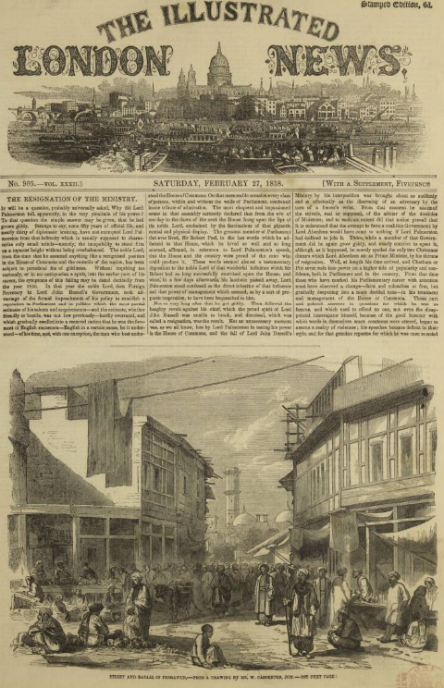
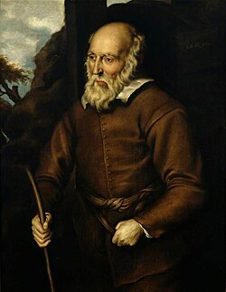
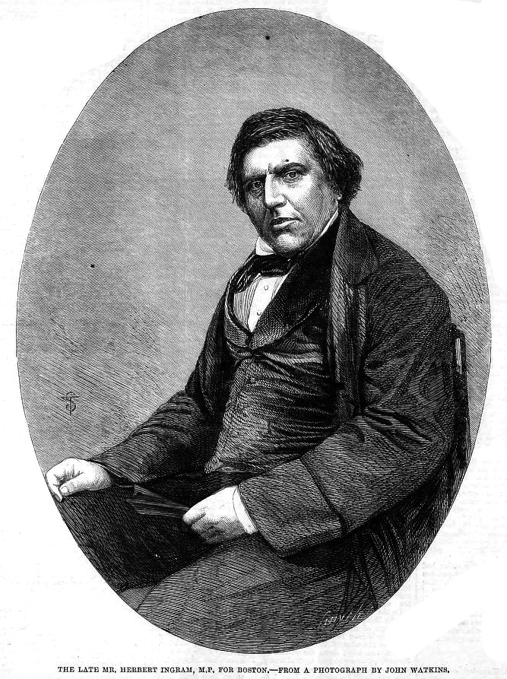
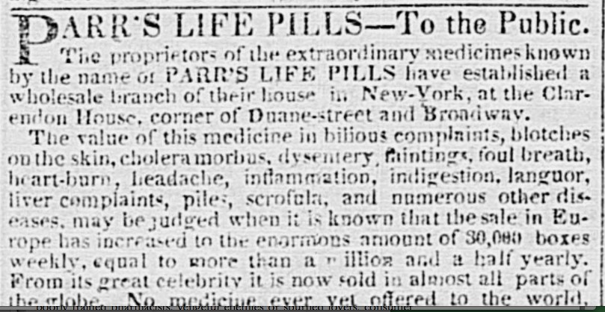
Competition
Herbert Ingram 1811-1860
Notes:
The Illustrated Times aimed to undercut the established Illustrated London News, which was the first illustrated periodical that became established in 1842. Herbert Ingram [CLICK] was able to finance this speculation having already made a fortune [CLICK] hawking a quack remedy, sold as Parr’s Life Pills – basically a laxative, proving that where there’s muck, there’s brass! To market this miracle cure, Ingram commissioned a history of Old Parr from a local schoolmaster and also engaged Henry Vizetelly to create a new portrait of this legendary character, an incredibly old but virile man from Shropshire (like me) whose longevity was claimed to be down to taking this medicine. I haven’t found a facsimile of the portrait created by Vizetelly, but [click] here is an earlier one to give an idea of Old Parr, looking suitably patriarchal. Vizetelly’s association with Ingram continued when the latter was planning the Illustrated London News. Vizetelly advised on tone and content and drafted the prospectus. Having seen its success, Vizetelly could now take advantage of the abolition of the stamp to create a serious competitor.

Slide 6
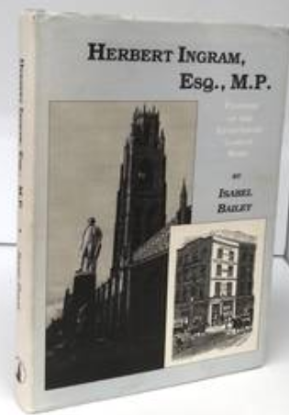
Relationships
Notes:
Vizetelly and Ingram had much in common. Each thought very highly of himself and his success and craved recognition. They were morally compromised characters – Vizetelly was often in trouble for his gambling habit. Ingram was a notoriously irascible character who managed to fall out with almost every associate involved with him, often violently. There were question marks over Ingram’s business ethics right from the start. It was also to emerge much later, in [CLICK] Isabel Bailey’s biography of Ingram, that there were allegations that he carried out sexual assaults on his sister-in-law, with repercussions on both family and business relations. Going back to Ingram and Vizetelly and knowing the kind of man each was, it is hardly suprising that relations between them over the years veered between collegiality and rivalry.

Slide 7
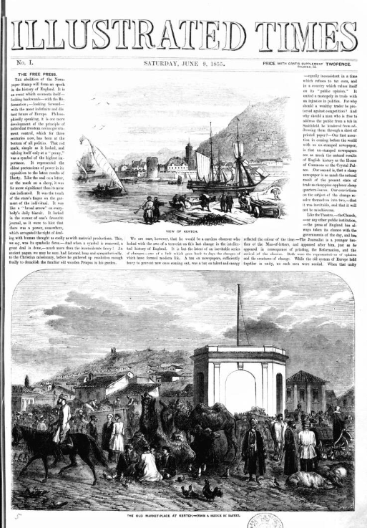
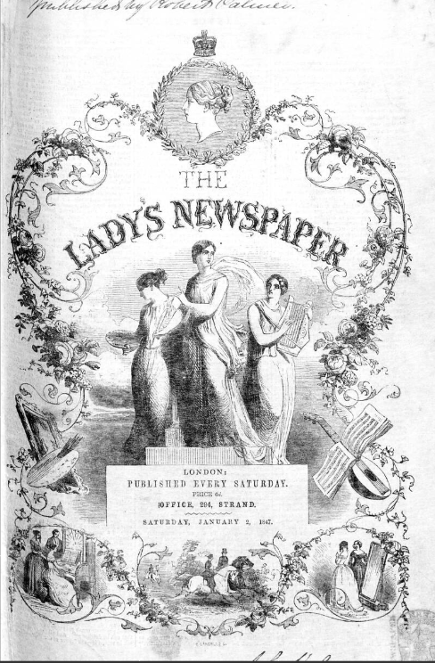
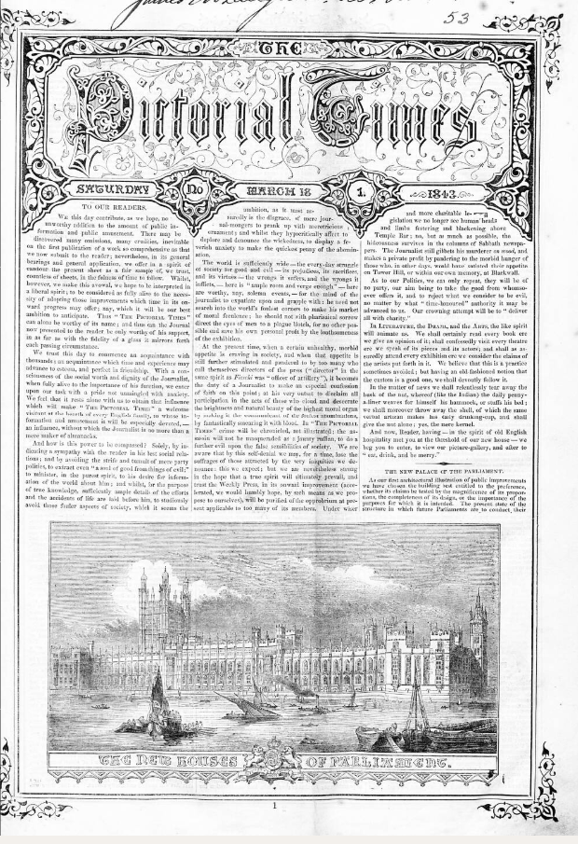
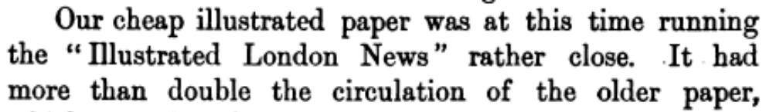
Launch
Earlier attempt at a paper by Vizetelly - Pictorial Times.
16-page illustrated weekly, 1843-48. At 6d same price as ILN.
By 1848 had lost £20,000. Bought out by Ingram, who merged it with his Lady’s Newspaper (launched 1847).
Notes:
The first attempt by Vizetelly to rival Ingram’s success in illustrated newspapers was with the Pictorial Times, (Times again!) [CLICK] which was launched in 1843, the year after Ingram’s paper. [CLICK] It had a similar format and price. [CLICK] According to Isabel Bailey, it was Ingram who bought out the competitor in early 1848 after it had sustained losses of £20,000, merging it with his own Lady’s Newspaper. [CLICK]. Vizetelly must have chafed at this failure. In any case, his second attempt [CLICK] was a runaway success. Vizetelly, with Bogue, sought to use the new regime to undersell the established paper and the impact was soon felt. Timing was crucial and, this time, Vizetelly got it right, later claiming [CLICK] that, within a very short time, the Illustrated Times was achieving double the sales of the established paper.

Slide 8
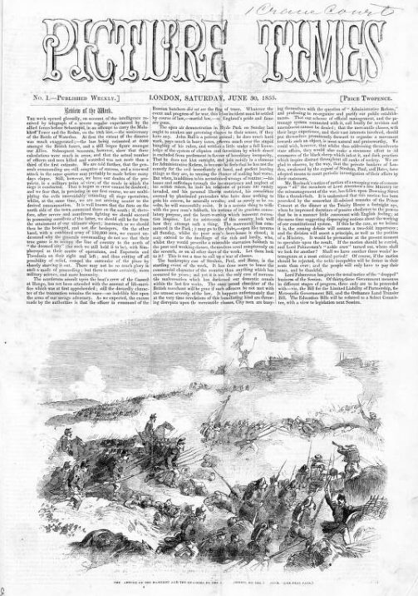

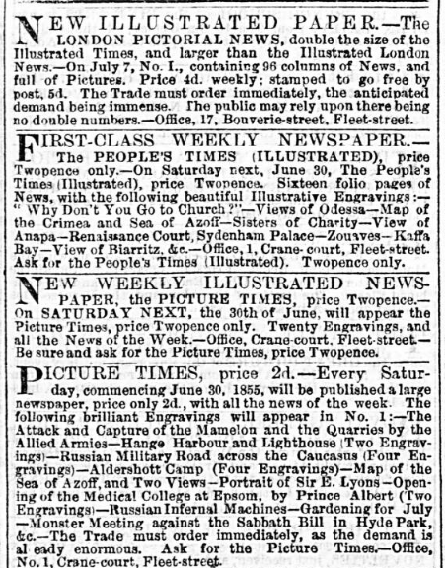
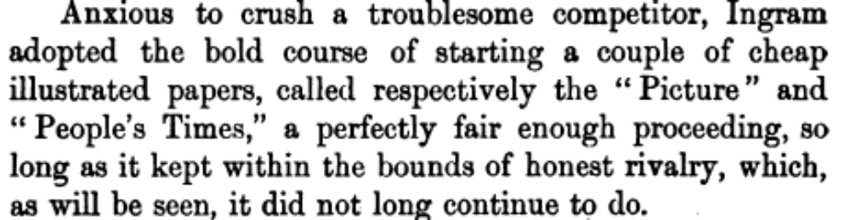
Retaliation
Options for Ingram?
Notes:
Herbert Ingram was not, obviously, the sort of man to accept such a challenge to his flagship publication meekly. What were his options? He could respond by cutting the price of his paper and/or reducing its size and cost, to compete with the newcomer on economic grounds. He did knock a penny off, acknowledging the repeal of the tax, but didn’t respond aggressively to the price war. Because of the success and profitability of the rival paper, it was not vulnerable to a buy-out. [CLICK] Instead, he fought fire with fire by launching new, cheap titles to compete with the newcomer directly. Advertisements anticipated the launch of both People’s Times and Picture Times – for example, [CLICK] in the Morning Herald on 28th June 1855, just two days prior to the publication date of the new illustrated papers. These show papers clearly aimed at the cheap price of the Illustrated Times. Ingram’s involvement, though, is not made explicit here. Archive copies of the People’s Times, which was very short-lived, are difficult to find. [CLICK] Here, though, is the Picture Times – with a name perhaps confusing similar.

Slide 9
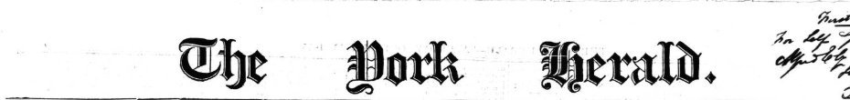

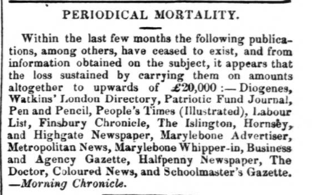
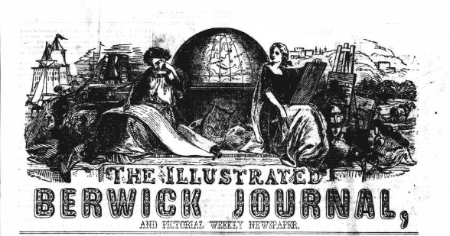

Retaliation
Notes:
Little is known about the People’s Times beyond its rapid demise. By early October, the [CLICK] York Herald, relaying an article from [CLICK] the Morning Chronicle, included the People’s Times in a selection of newspapers recently closed down (the article is headed ‘Periodical Mortality). [CLICK] By March 1856, the London Correspondent of the [CLICK] Illustrated Berwick Journal (isn’t that a fantastic masthead, by the way!) offered further detail on the fate of the People’s Times: [CLICK] ‘When the Illustrated Times started, Mr. Ingram opposed this new rival to the Illustrated News, by the Picture Times and the People’s Times, the latter having been speedily allowed to die, to show how the cheap illustrated press could not live!’ ‘ That’s one way to do it. It must have helped that Ingram could afford to make such a gesture.

Slide 10
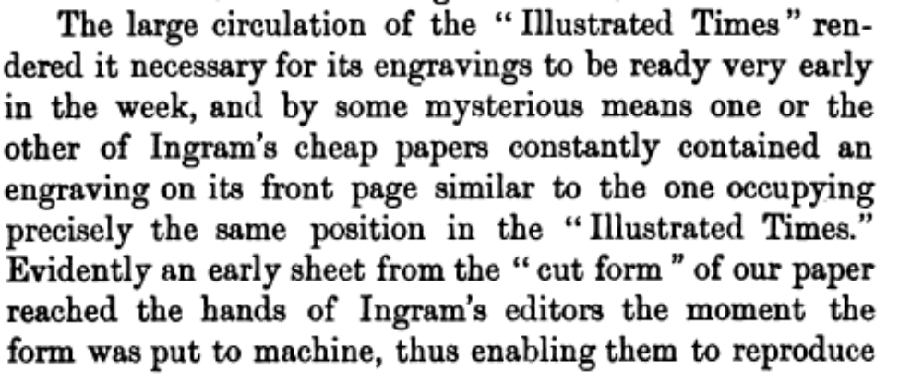
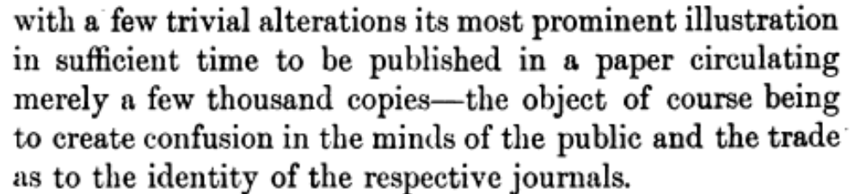
Allegation
Notes:
So far, this has been a tale of a highly competitive business being exploited by two canny operators. Vizetelly, however, later claimed that Ingram had deployed a form of industrial espionage to damage the Illustrated Times. In his own words [click]: ‘The large circulation of the “Illustrated Times” rendered it necessary for its engravings to be ready very early in the week, and by some mysterious means one or the other of Ingram’s cheap papers constantly contained an engraving on its front page similar to the one occupying precisely the same position in the “Illustrated Times.” Evidently an early sheet from the “cut form” of our paper reached the hands of Ingram’s editors the moment the form was put to machine, thus enabling them to reproduce with a few trivial alterations its most prominent illustration in sufficient time to be published…the object of course being to create confusion in the minds of the public and the trade as to the identity of the respective journals.’ This is serious stuff. Could Ingram have acted in this way? What we know of his character suggests that he certainly could have done. But can the allegation be substantiated?

Slide 11
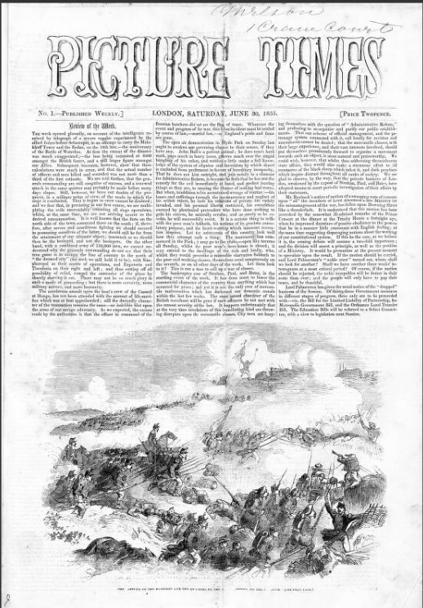
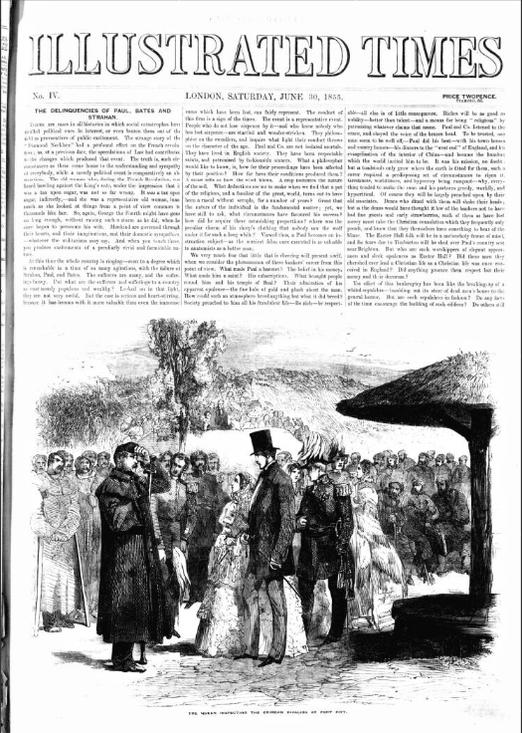
Analysis
Vizetelly
Ingram
Notes:
Here is the first number of Picture Times, on the left, appearing on 30th June 1855 – on the same day as the fourth issue of the Illustrated Times. The image from Picture Times is from the Crimean war and entitled ‘The capture of Mamillon and its Quarries by the Advancing Armies on the 8th June’. The other paper depicts ‘The Queen Inspecting Crimean Invalids at Fort Pitt’. So there’s some thematic consistency but I can’t see how these could be confused.

Slide 12
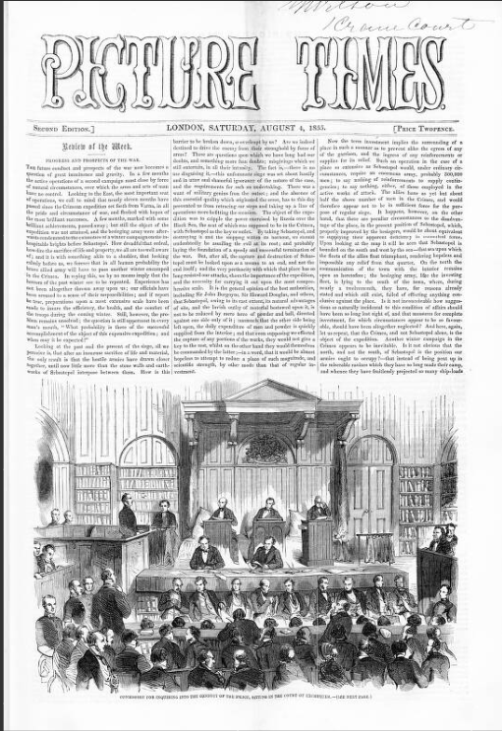
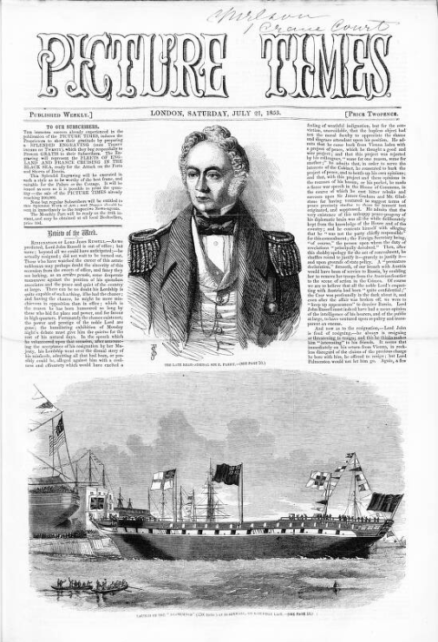
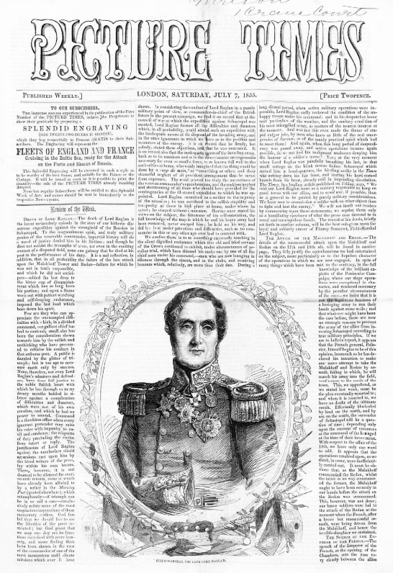
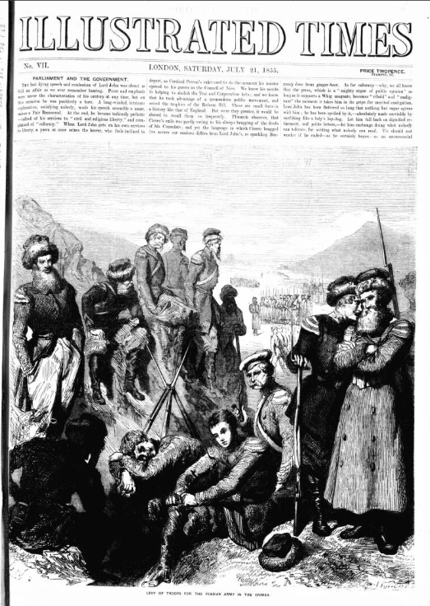
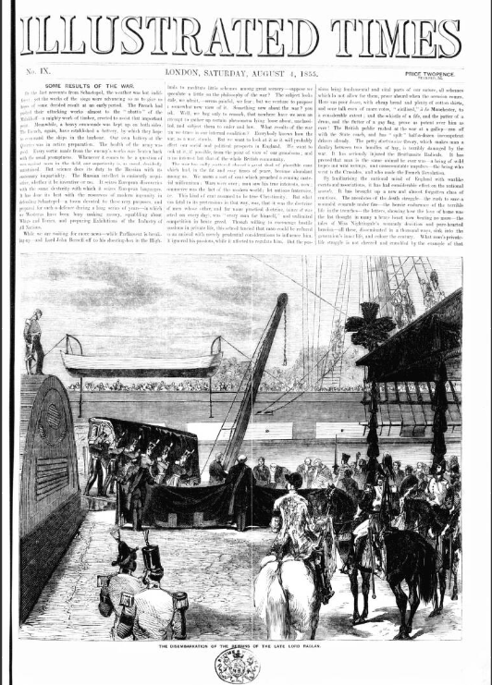
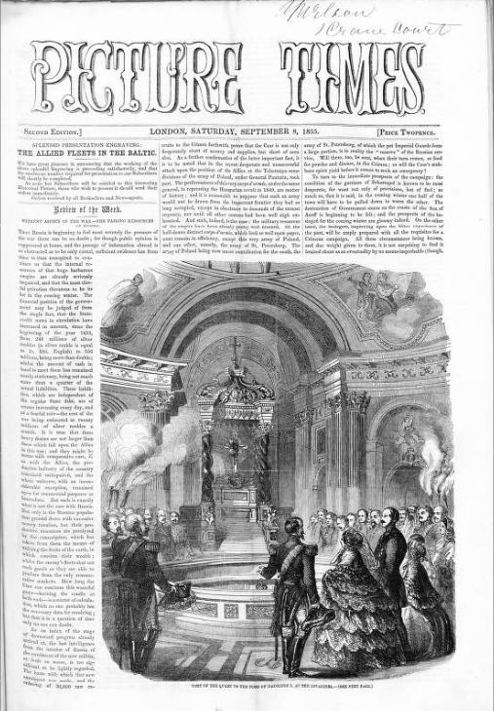
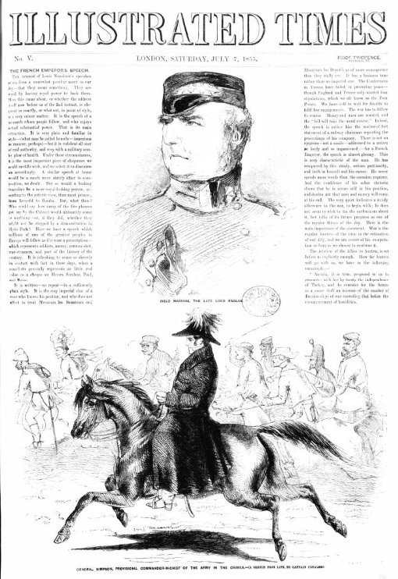
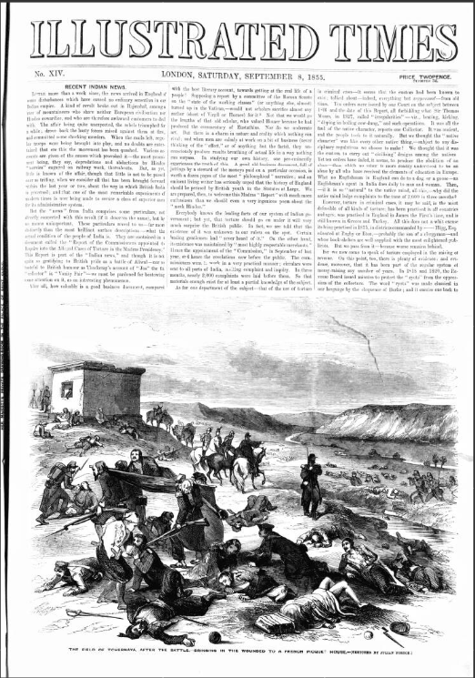
Ingram
Vizetelly
Notes:
Here is a comparison from the next week’s editions. Both contain illustrations of Field Marshal the late Lord Raglan who had recently died in the Crimean War. Albeit with some thematic consistency, there is so little similarity in the engravings that Vizetelly’s protest again rings rather hollow. Here are further comparisons from 21st July [CLICK]; 4th August [CLICK] and 8th September [CLICK]. None of these comparisons support Vizetelly’s retrospective claim. I also checked to see if there was any comment made in the Illustrated Times concerning these alleged dirty tricks. I found nothing. But Vizetelly was clearly annoyed about the appearance of this rival, to judge by what he himself called his ‘spiteful’ riposte.

Slide 13
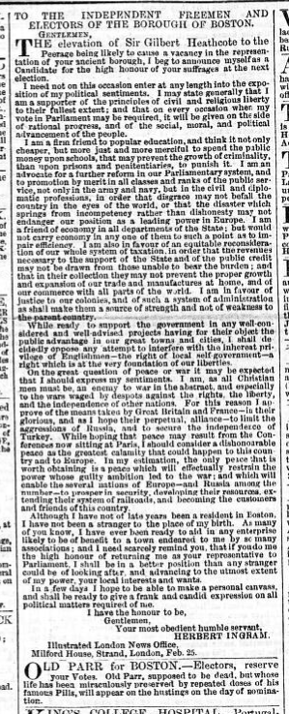
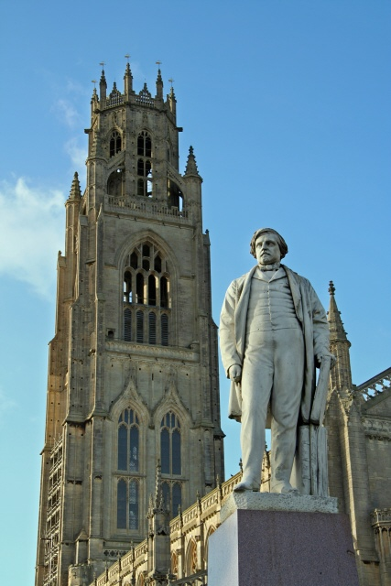

Riposte
Notes:
Like many self-made men, Ingram was desperate for respectability. He became a member of parliament for his home town of Boston, Lincolnshire in 1856 and was still the sitting MP at the time of his death in 1860. During his campaign, Vizetelly took delight in reminding Ingram’s electorate of the source of his fortune. Printed underneath Ingram’s election address in almost every paper, [CLICK] Vizetelly inserted a short piece entitled ‘Old Parr for Boston’ You can see the positioning here – and [CLICK] here is Vizetelly’s ad enlarged. Ingram did overcome this to be elected and, allying himself with reformist politics, is memorialised by this statue [CLICK] in Boston. He was, however, stung by Vizetelly’s own dirty trick.

Slide 14
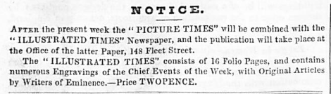
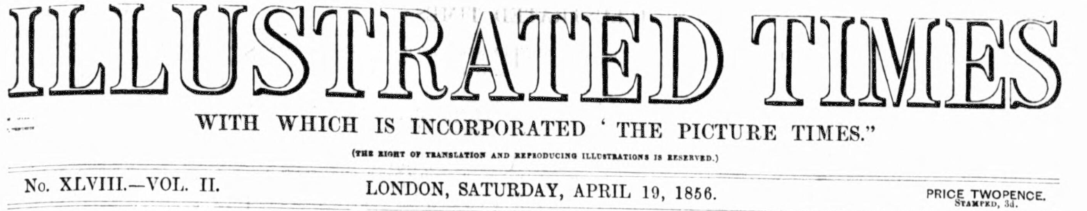
Outcomes
Notes:
After the ‘Old Parr’ trick, a practical compromise was reached between Ingram and Vizetelly; Picture Times was absorbed into the Illustrated Times. [CLICK] This was announced in this advertisement on 12th April 1856. Following the absorption, briefly the masthead of the Illustrated Times contained this subtitle. [CLICK]
As part of this resolution, Ingram purchased a one-third share in the [CLICK] Illustrated Times, thus benefiting from the cheaper paper’s success while retaining his original offering, [CLICK] the Illustrated London News, as the higher-priced alternative. The two papers co-existed until 1872, when the Illustrated Times announced that it was merging into a periodical entitled Zig-Zag.

Slide 15
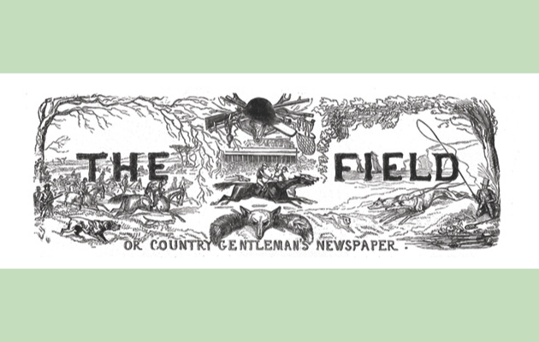
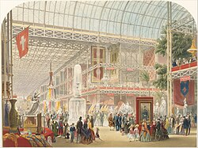
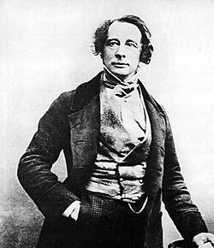
Culture
I am disposed to think that the tax increases their respectability – that they have a fair return for it in the postage arrangements – and that if it were taken off, we might be deluged with a flood of piratical, ignorant and blackguard papers, something like that black deluge of Printer’s Ink which blights America.
A cheap press can exist only by a great circulation, and must look downward for that to the classes below the present newspaper buyers’, the Field continued, and ‘if they write for a lower class, they must written down to the lower tastes; … they must flatter their passions and prejudices’; this ‘is the fearful experiment which the madness of our rulers is about try in an old country’
Notes:
The place of newspapers in nineteenth-century society was continually contested. They were businesses dependent on sales and advertising revenue, yet they were also the Fourth Estate of the Constitution. They were a symbol of the struggle for freedom and also an emblem of repression. Even in attitudes to the repeal of the various taxes, there were surprising supporters of a taxed, economically-regulated press. Here is an opinion from Charles Dickens, written in 1850. [CLICK] ‘I am disposed to think that the tax increases their respectability – that they have a fair return for it in the postage arrangements – and that if it were taken off, we might be deluged with a flood of piratical, ignorant and blackguard papers, something like that black deluge of Printer’s Ink which blights America.’ [CLICK] A piece in The Field was, unsurprisingly, even more strident, saying: ‘A cheap press can exist only by a great circulation, and must look downward for that to the classes below the present newspaper buyers’, the Field continued, and ‘if they write for a lower class, they must written down to the lower tastes; … they must flatter their passions and prejudices’; this ‘is the fearful experiment which the madness of our rulers is about try in an old country’. The relationship between the state, the press and the public was, then a complex and evolving one. Even after repeal of the main taxes, there was an inevitable shake-up of the existing order, that, over time, laid the foundations for the mass media of the twentieth century.

Slide 16
Answers
What were the alleged ‘dirty tricks’ practised against the Illustrated Times?
What evidence remains to support or refute those allegations?
What does this episode reveal about the nature of the newspaper business (and broader culture) in the mid nineteenth-century?
Notes:
To return to the questions with which I started, the allegations of copying, or plagiarism, or espionage levelled by Henry Vizetelly against the Picture Times were made only in his memoirs, written many years after the events alleged. Vizetelly, like Ingram, was somewhat prone to self-aggrandizement, so his claims must be taken in the context of his character. There is little evidence to support the claim he made, though his very personal attack on Ingram’s parliamentary ambitions seems to have prompted a resolution satisfactory to all. This episode demonstrates just how precarious and cut-throat a business the newspaper press was, and how much uncertainty was caused by the repeal of the main taxes. In this, it was emblematic of the nineteenth century’s increasingly industrial, capitalist society in which self-made men, entrepreneurs, were increasingly challenging the established order. It also shows that individuals rewriting the past to make their own triumphs seem more heroic in retrospect is as old as time and continues today.

Slide 17
End
Thank you
Dr Matthew Stephens
Applied History Fellow, Institute of Historical Research
Bluesky social: @C19thnewshound@bsky.social.com
LinkedIn: https://www.linkedin.com/in/matthew-stephens-389070292/
https://www.matthewstephens.org.uk/

