Slide 1
A tale of two cities
New York, London and the mystery of The Days’ Doings
Dr Matthew Stephens
Institute of Historical Research

Slide 2
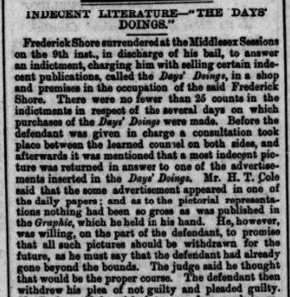
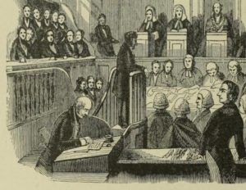
prosecution
Notes:
We start in court – at the Middlesex sessions on 9th February 1872. This report, from the Maidenhead Advertiser on 14th February, details the final legal pronouncement on a weekly paper that had enjoyed and endured a scandalous eighteen months in print and was now castigated as ‘Indecent Literature’ – The Days’ Doings. It had been hounded to the brink of extinction by the self-appointed moral arbiters of the Society for the Suppression of Vice – but how did it get here?

Slide 3
questions
Who was responsible for the salacious publication that caused this localised moral panic?
What were the origins of The Days’ Doings?
What can be inferred about the motivations for migrating an American illustrated periodical to Britain?
To what extent was the transatlantic repackaging a success?
Notes:
The questions I shall be seeking to answer in this presentation are:
Who was responsible for the salacious publication that caused this localised moral panic?
What were the origins of The Days’ Doings?
What can be inferred about the motivations for migrating an American illustrated periodical to Britain?
To what extent was this Transatlantic repackaging a success?

Slide 4
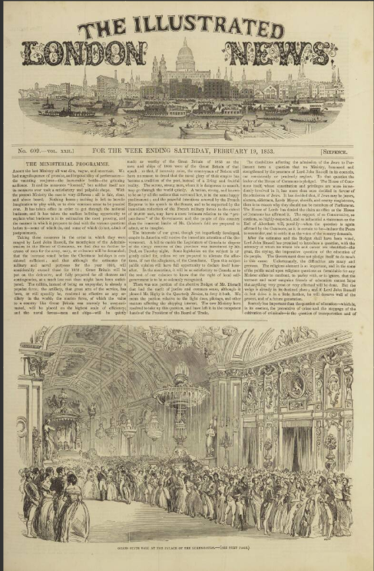
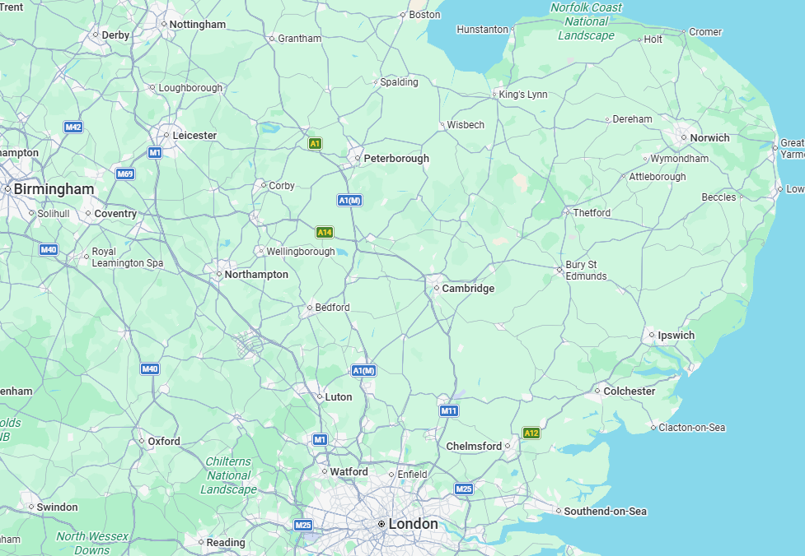
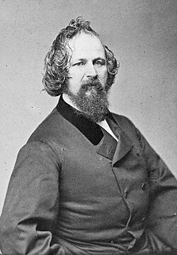
Ipswich
Henry Carter/Frank Leslie
ILN connection
Sailed to the US
Henry Carter/Frank Leslie,
1821-1880
Notes:
This journey starts in Ipswich, [click] the county town of Suffolk on the Eastern bulge of England. Here, on 29th March 1821, was born [click] Henry Carter, the son of successful glove manufacturer Joseph Carter. Growing up in Ipswich, Henry showed an early interest in the skills of engraving, yet he was sent [click] to London at 17 to learn the family glovemaking business with his uncle. In his spare time, he applied himself secretly to his passions of sketching, drawing and engraving. Soon after Herbert Ingram had launched [click] the Illustrated London News in 1842, Henry Carter began contributing engravings to it and, to ensure his identity was concealed from disapproving relatives, he used the pseudonym Frank Leslie.

Slide 5
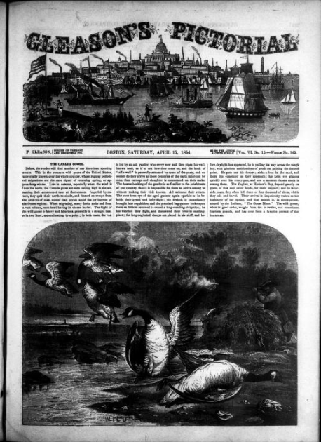
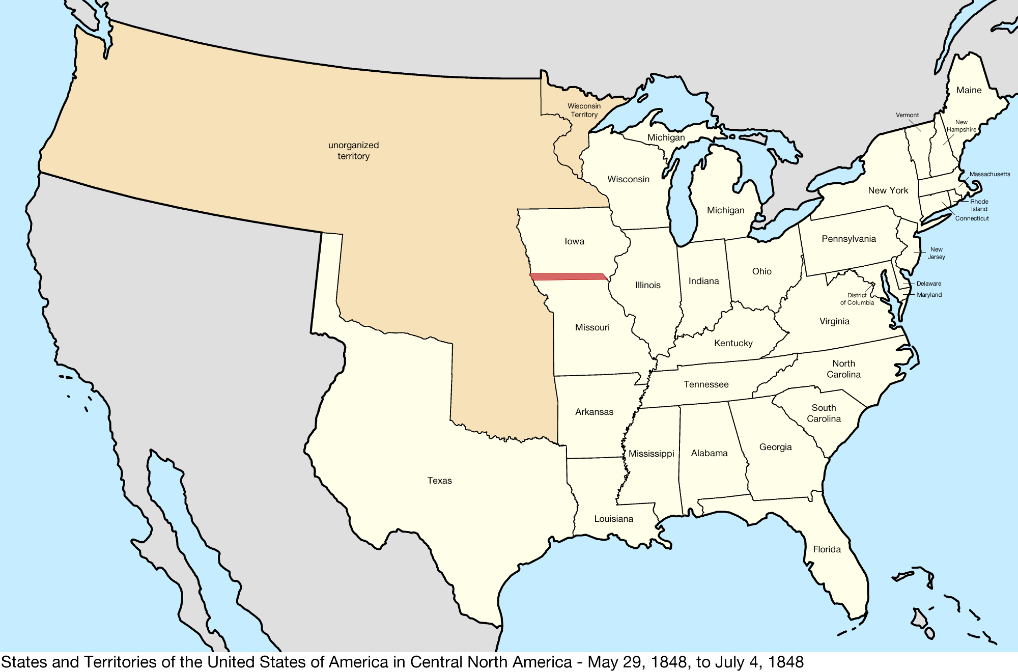
BOSTON
(Ma)
Notes:
Henry Carter emigrated to the United States in 1848, at around 27 years old, with a wife and young family. By 1852, he was working for a pictorial paper, [click] Gleason’s which had launched the previous year in [click] Boston, Massachusetts,. The form of Gleason’s Pictorial, certainly the front page, would have looked familiar to readers of [click] the Illustrated London News. Perhaps Carter’s contribution accounted for some of this similarity. In any case, this association did not last long – Carter had his eyes on a bigger prize.

Slide 6
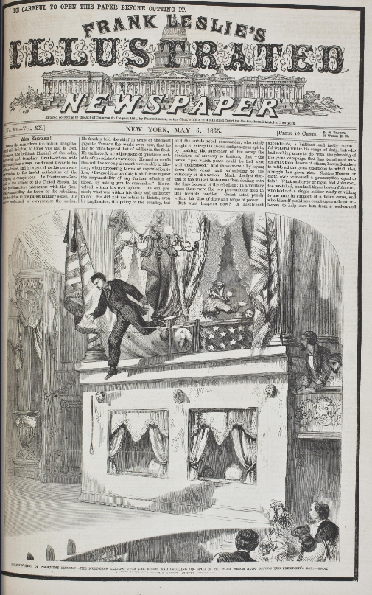
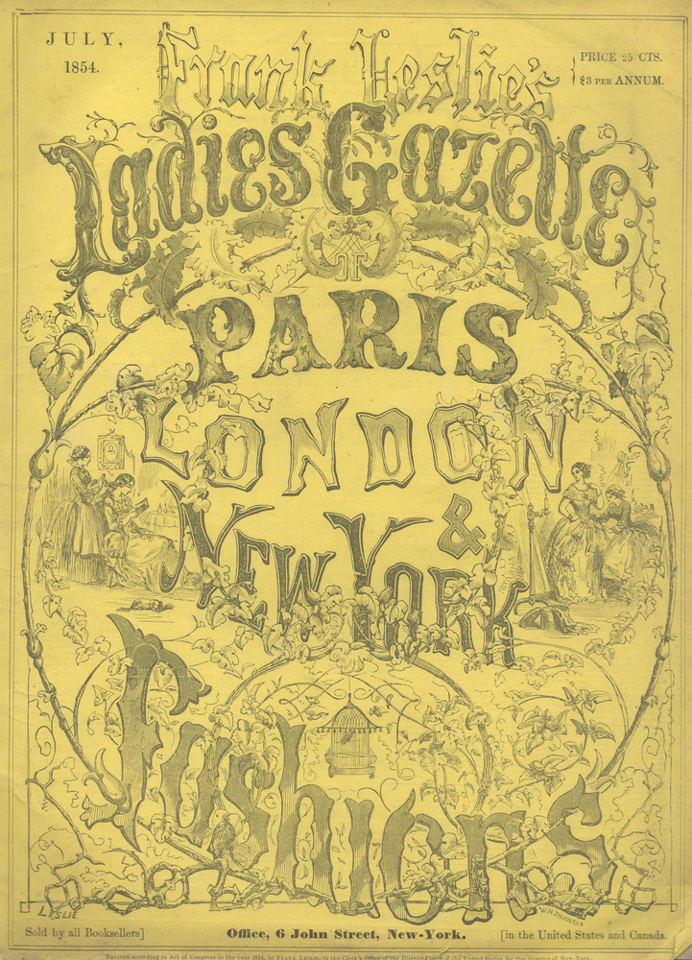
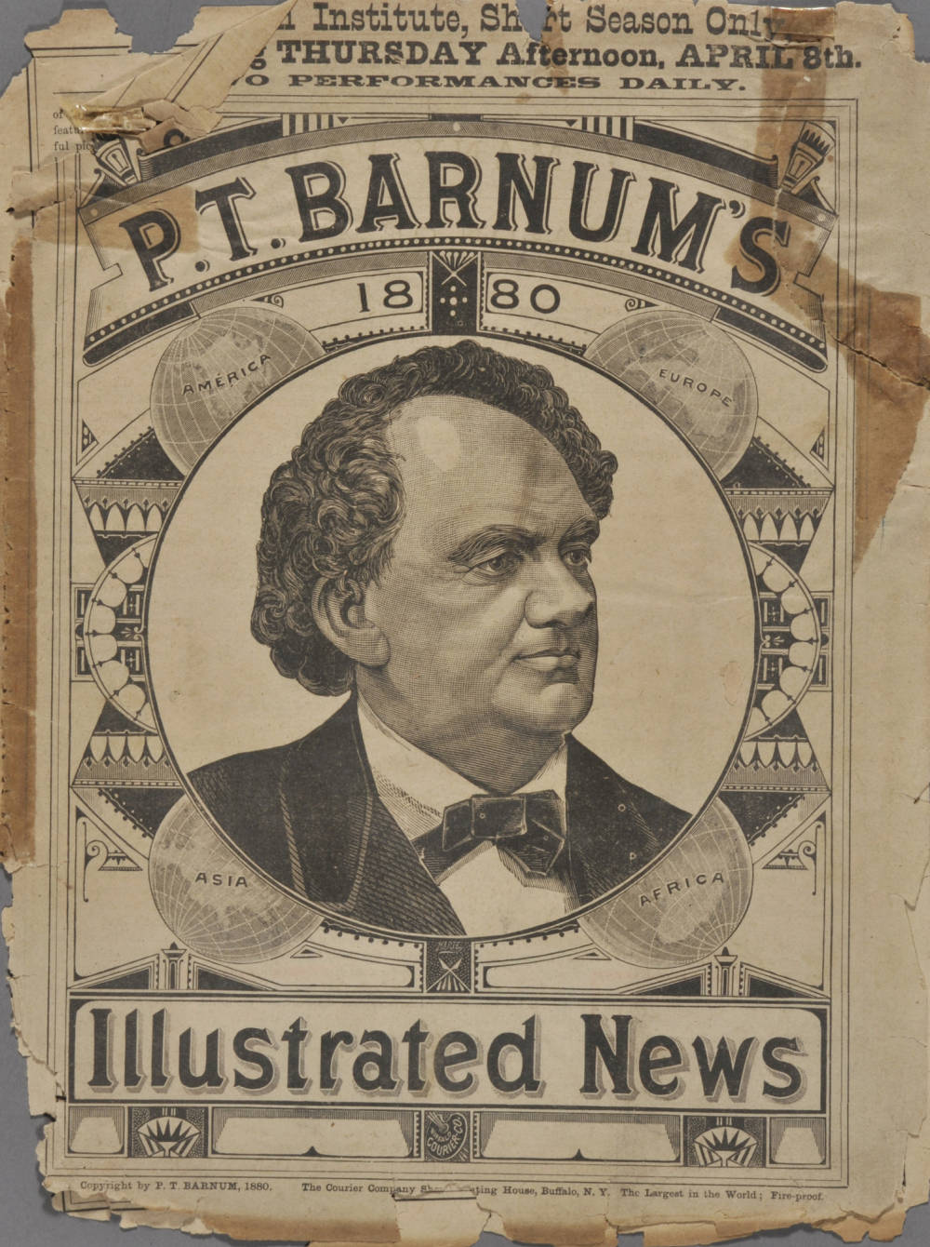
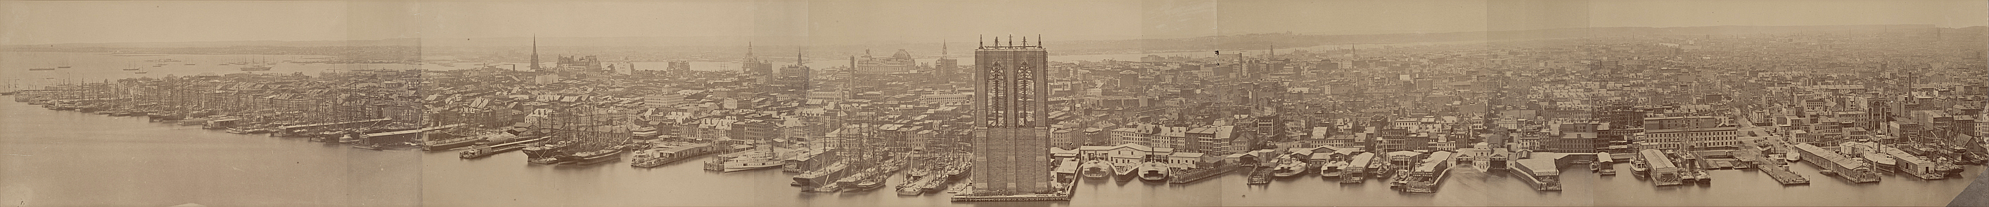
NEW YORK
Notes:
Moving to New York City in 1853, Carter began by engraving woodcuts for [click] the Illustrated News, launched by showman P T Barnum. However, he soon had the means to launch, finally, his own titles. He began [click] with Frank Leslie’s Ladies’ Gazette of Fashion and Fancy Needlework in early 1854. By 1855 he hit the jackpot with [click] Frank Leslie’s Illustrated Newspaper which included news and fiction and was to be his most successful and longest-running publication, remaining in print until 1922. In 1857, he legally adopted the name Frank Leslie – Henry Carter of Ipswich was no more. As Leslie, he continued to produce other titles targeted at particular sectors of the market – there were periodicals for children and others aimed at older readers in search of fun, like the one on the next slide…

Slide 7
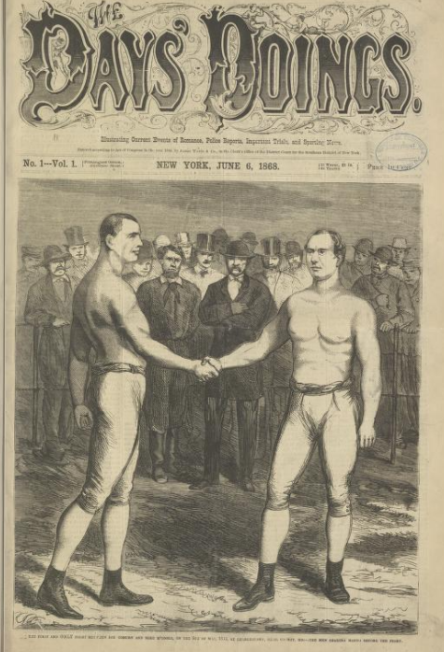
Days’ Doings
June 6, 1868
16-page weekly
No editorial column
No statement of aims
Notes:
The Days’ Doings, which appeared in June 1868. Retailing at 10c, this weekly illustrated paper’s strapline promised to cover ‘Current Events of Romance, Police Reports, Important Trials and Sporting News.’ This, together with an image of a bare knuckle boxing match, suggested an element of danger in the content. The paper made no statement of intent or any editorial comment at all in this first number – clearly the intention was to keep readers guessing.

Slide 8
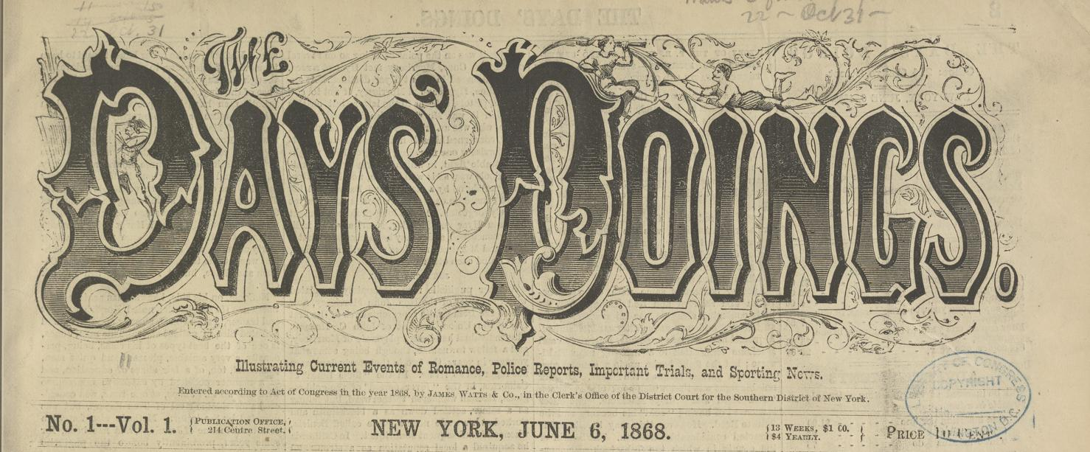
Notes:
Unlike its eponymous stablemate, the Days’ Doings was not openly identified with Frank Leslie – the listed publisher is [click]

Slide 9
Notes:
‘James Watts and Co. There were, however, clues to the proprietor’s identity, such as reprints of engravings previously published in Frank Leslie's Illustrated Newspaper. More decisively, Leslie’s association with the paper was uncovered fully by Madeleine Stern in her biography of Leslie’s widow Miriam, who took on his publishing business after his death in 1880. During its life, the New York The Days’ Doings became the repository for more sensational content, which from that point did not appear in the Illustrated Newspaper. It’s an early example of a proprietor developing a stable of titles to cater for different tastes and audiences. So what was the content of The Days’ Doings?

Slide 10
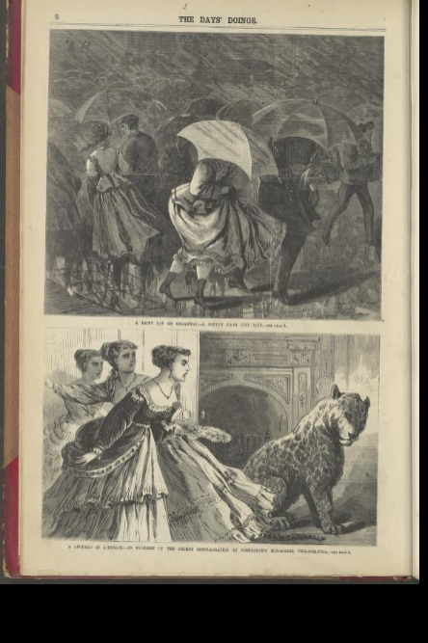
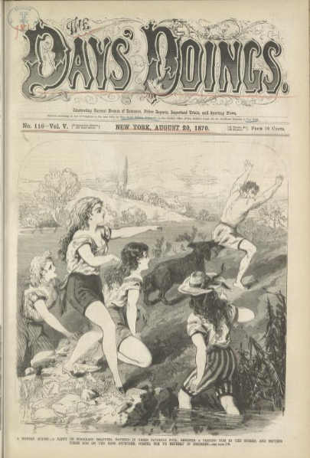
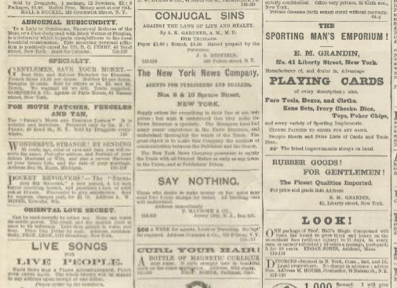
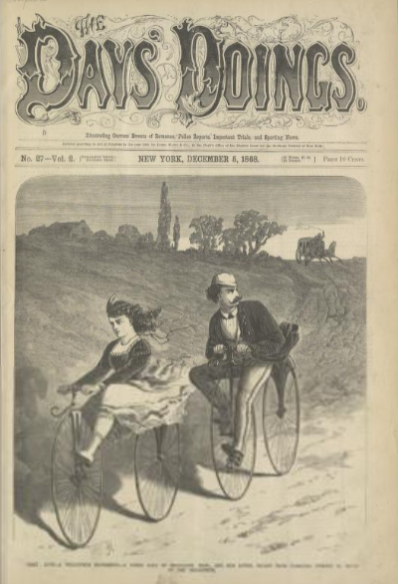
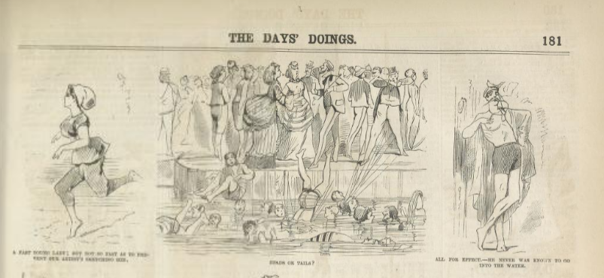
Notes:
Here from December 1868 is a front page engraving of an ‘elopement by velocipede’ – very daring and modern! Other pictures in this issue include [click] ‘A rainy day on Broadway’ above and ‘A Leopard in a Parlour’ below. [click] In this edition from August 1870, the pictures are definitely more racy – this front page of bathing beauties setting their dog on a peeping Tom is only slightly ameliorated with its classical reference to a ‘Modern Actaeon’, and is supplemented by [click] similar illustrations inside and, towards the back, [click] advertisements for unequivocally sexual products – I don’t’ think there’s much doubt about the use of ‘Rubber Goods for gentlemen’ in the right hand column! Having established this title successfully in the USA, evidence suggests that Frank Leslie make a bold attempt to migrate this format back to the land of his birth.

Slide 11
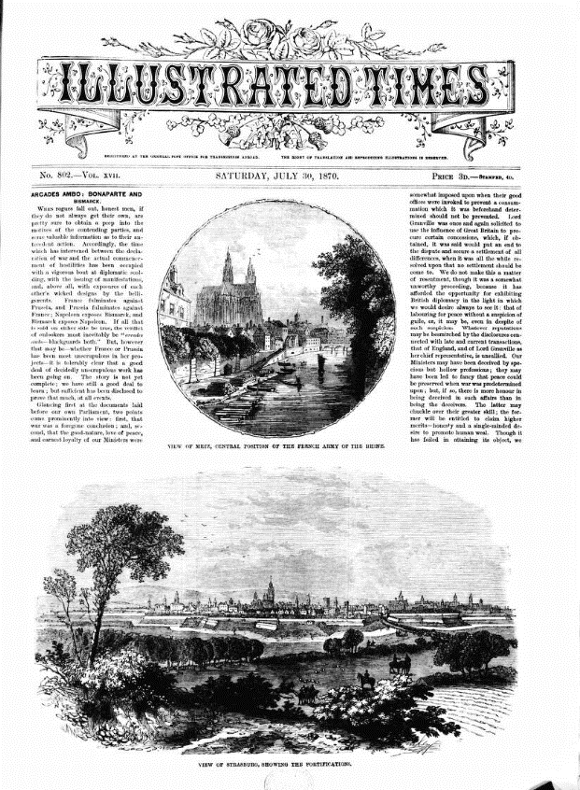
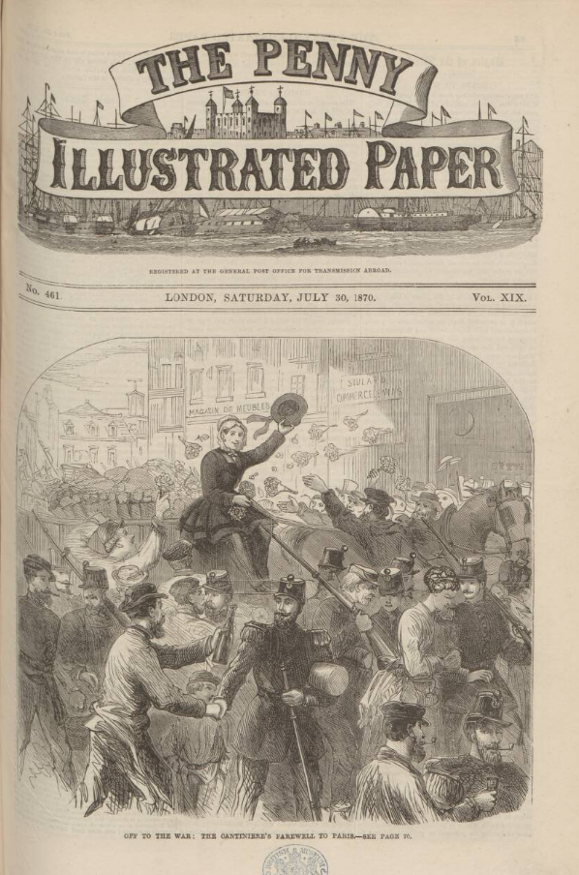
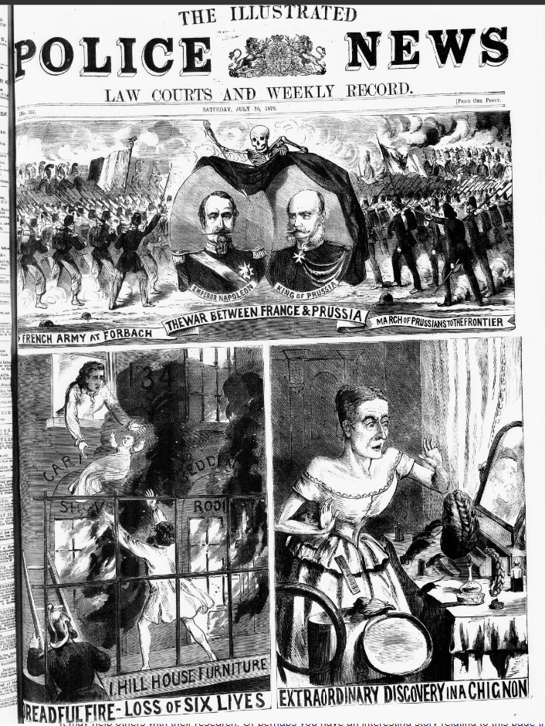
London
30th July 1870
Notes:
On 30th July 1870, the major illustrated newspapers in London were presenting images of the start of the Crimean War. [click] The Illustrated Times takes a sober tone, depicting fortifications in France. [click] The Illustrated Police News has as its lead illustration images of the French and Prussian armies marching towards each other. [click] The Penny Illustrated Paper also devotes its front page to a war-themed image. Clearly, the conflict was dominating the news coverage of the day. As wars traditionally led to an increased appetite for news, this was a propitious time to launch a new publication; and so, on the same day a new illustrated paper appeared, also leading with an image from France. There, however, the similarities end.

Slide 12
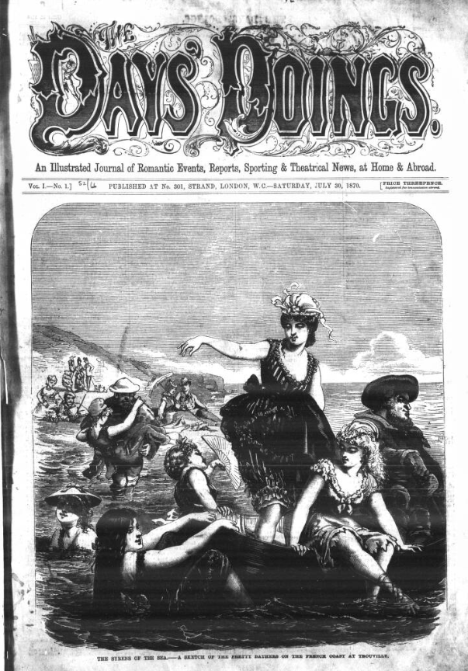
doings
The Old Order of Things is changed, and a New Style of Journalism and Illustration has made its advent…Our intention is to amuse; and, leaving to others the task of continuing the old system, we shall carry out our ideas of Novelty, Fun, and Frolic.
The Days’ Doings, 30th July 1870
Notes:
The first number of The Days’ Doings in London shows a daring full-page illustration of young French sea-bathers. A column on the second page describes their ‘addiction’ to bathing and the ‘abandon’ with which it is enjoyed by these young Gallic women. Their appearance in bathing costumes, together with language drawing attention to their comparative freedom are all deliberatively provocative – and consistent with what was being published in the American Days’ Doings at this time. The London paper’s likely readership of educated middle-class men was being given a taste of the erotic in the ‘safe’ context of foreign climes. The paper’s opening editorial [click] boldly proclaimed: ‘The Old Order of Things is changed, and a New Style of Journalism and Illustration has made its advent…Our intention is to amuse; and, leaving to others the task of continuing the old system, we shall carry out our ideas of Novelty, Fun, and Frolic.’ The masthead [click] is identical to the New York version apart from the strapline – British readers were being offered ‘An Illustrated Journal of Romantic Events, Reports, Sporting & Theatrical News, at Home & Abroad’. The proprietor was – and remains – anonymous – just like the New York original.

Slide 13
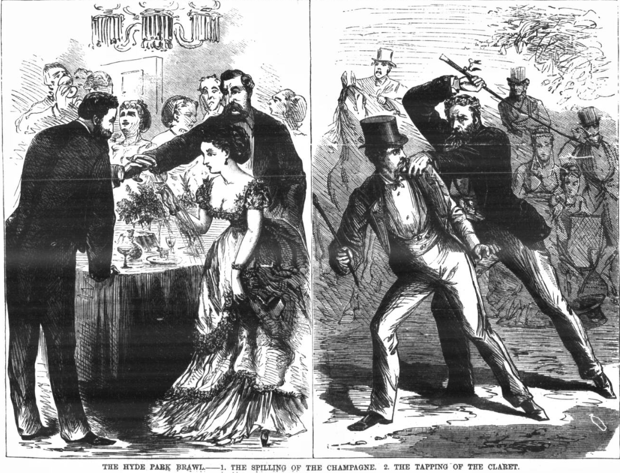
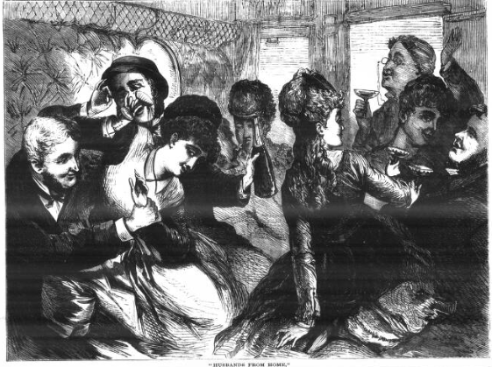
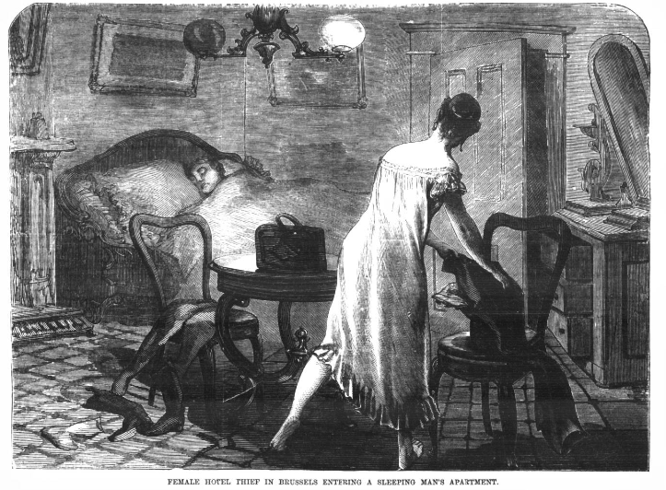
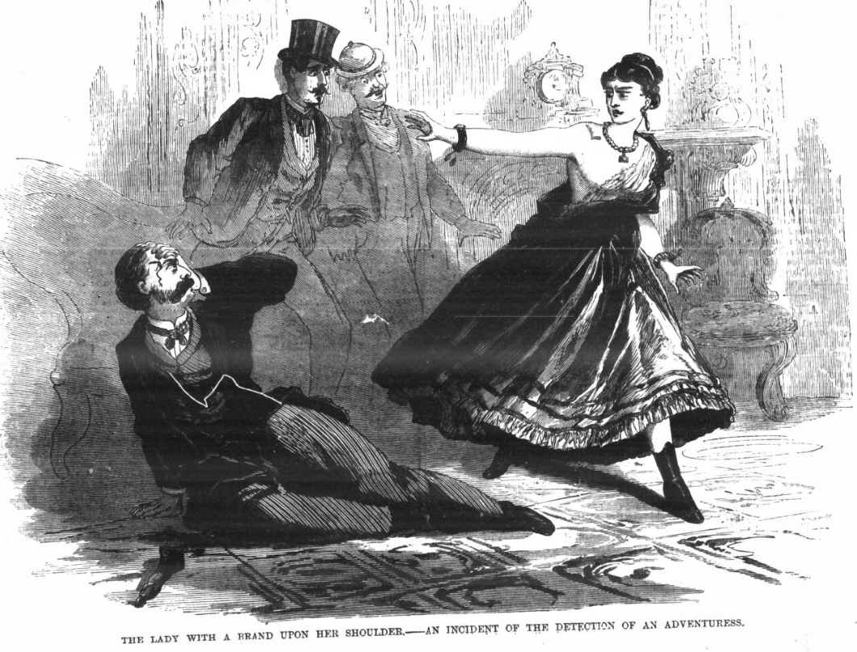
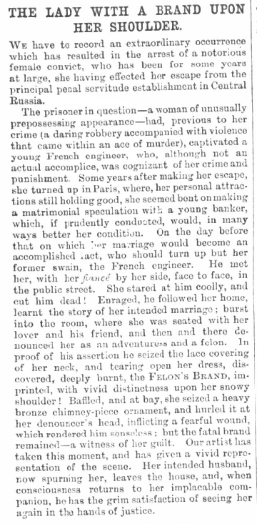
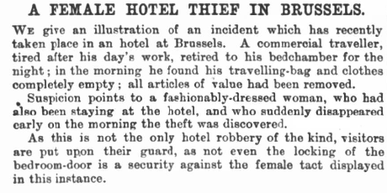
Illustration (London)
Notes:
In terms of general content, there is little coverage of ‘hard’ news. There is no mention of the outbreak of war. There are no parliamentary reports; and foreign and imperial matters appear in summary form, as ‘Doings Abroad’. The focus was on sensation. The first issue contained [click] a story of the apprehension of a notorious female criminal in Paris, betrayed by a brand on her shoulder; another [click] features a woman in Brussels stealing from a hotel guest while he slept. In the related illustration she appears in only a nightdress. There’s also [click] a brawl in Hyde Park occasioned by an argument between two gentlemen over a glass of wine spilt over the dress of an undeniably buxom young lady. The recurrent motif is creating occasions to illustrate young, attractive women, ideally less than fully-dressed and these illustrations were a key factor in the publication’s ‘identity’. In the second number [click] is an article and engraving describing a ‘spree’ in a railway carriage with several unmarried young women and quantities of alcohol. Although all participants are respectably dressed in the image, locating it in England was inviting disapproval. These attempts to frame and justify potentially obscene engravings were to reach a peak in the third issue, though by recreating a work of contemporary art the paper claimed a more didactic purpose.

Slide 14
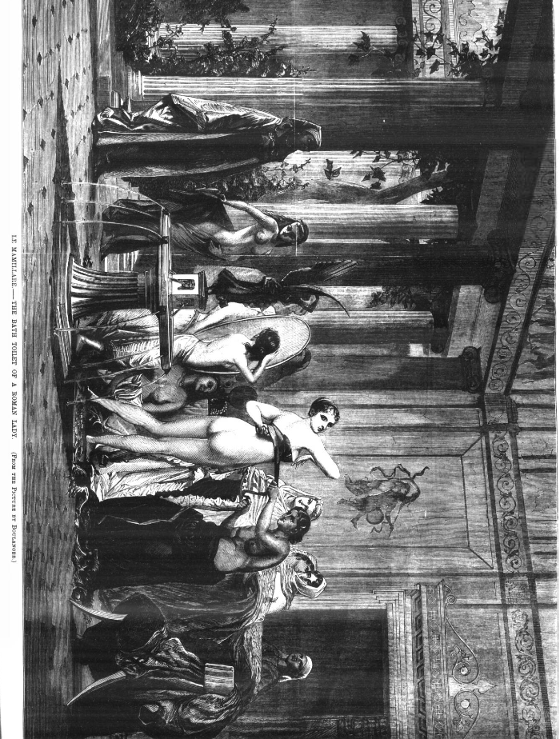
Notes:
Given the prevailing moral standards of the time, it is not difficult to see why this etching of ‘Le Mamillare’, an 1867 work by French artist Boulanger, was controversial, although the illustration is a commendably accurate representation of a work of fine art. This is where arguments concerning taste become relevant; what may have been acceptable when displayed in an art gallery (and a foreign one at that) is very different to what could be sold openly in the 1870s in England. The graphic nudity displayed here, despite its classical setting, was provocatively pushing at the moral boundaries of mid-Victorian society. This seems to have been the intention of the proprietors from the outset. This depiction inevitably caused an outcry, with the Lord Mayor of London undertaking to convict anyone selling this issue. In response, the publisher made a provocative point of selling it openly outside the mayor’s official home. This was the start of what became a protracted legal battle.

Slide 15
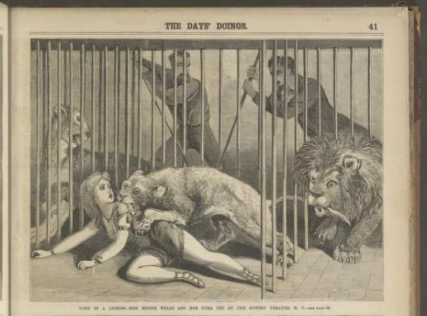
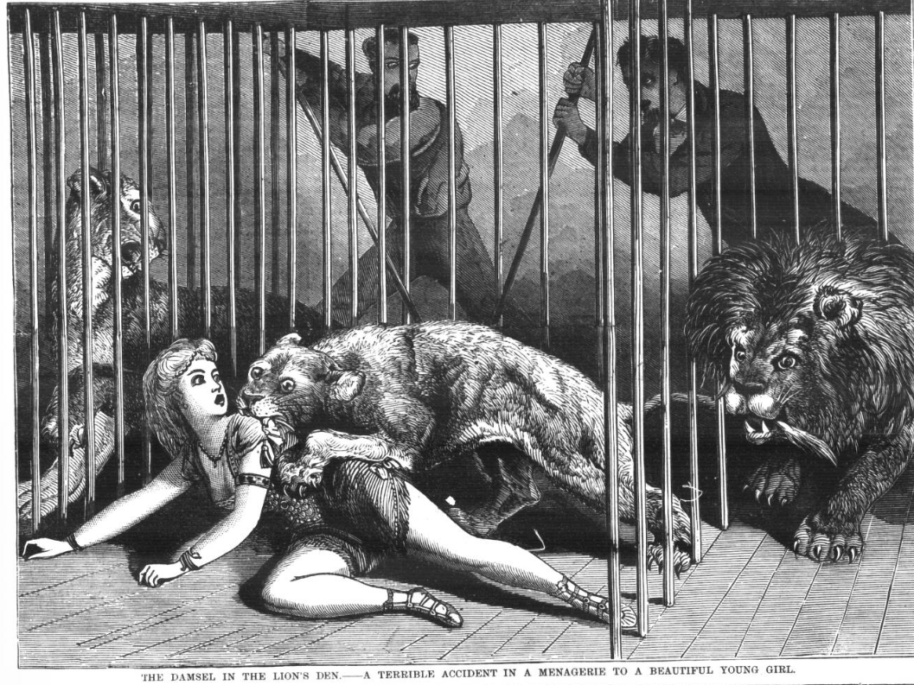
Synthesis?
New York Days’ Doings Features
Whispers about women
Ripples of romance
Echoes from the avant scene
London Days’ Doings Features
Doings abroad
Dramatic doings
Sporting doings
‘Torn by a Lioness’ - The Days’ Doings (US), 18/07/1870
‘The Damsel in the Lion’s Den’ – The Days’ Doings (UK), 30/07/1870
Notes:
It has been argued that the, London Days’ Doings was merely ‘the British edition the New York paper.’ Was it? It seems unlikely that Leslie himself could have supervised the London publication personally for the majority of its time. Transmission of content would also have been a slow process. But I tested the assertion by comparing the first London edition (30th July 1870) with the New York publications throughout June, July and August 1870. The US paper had a number of regular features – articles entitled [click] ‘Whispers about Women’, [click] ‘Ripples of Romance’, [click] ‘Echoes from the Avant Scene’. None of these appear in the London paper. Neither are the serial stories reprinted, as might have been expected. Features that would go on to recur in the British paper included [click] ‘Doings Abroad’, [click] ‘Dramatic Doings’, ‘[click] and Sporting Doings None appears in the American paper. I thought perhaps the illustrations – the most labour-intensive and costly part of the production process – might be shared. In some cases, this did happen. [click] Here’s a picture and caption from the New York Days’ Doings on 18th July 1870. Here [click] is the same image in the London paper with a different caption – damsel could only have been in the British paper! But this is a rare example. The engraving of ‘Le Mamillare’ never appears in the New York paper.

Slide 16
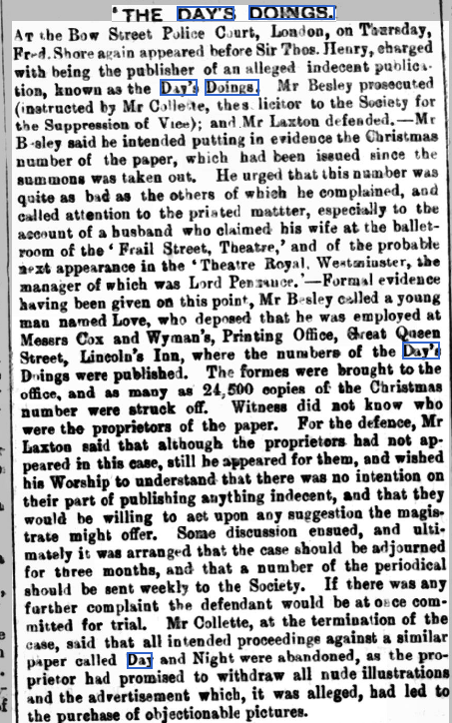
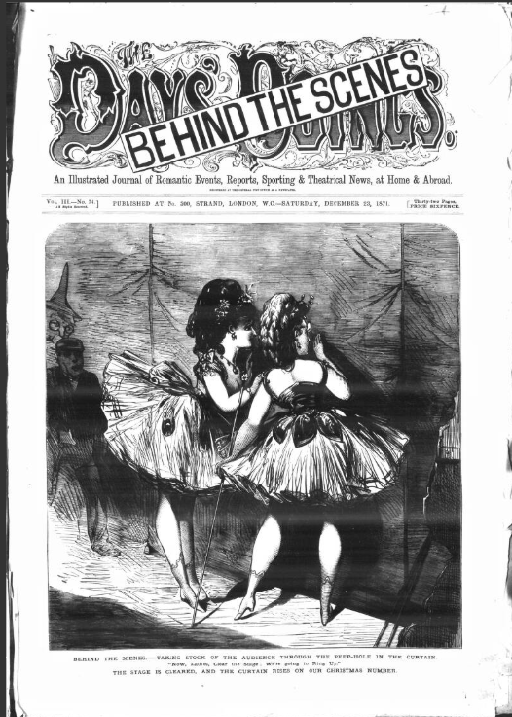
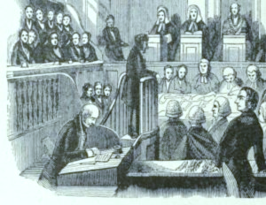
Action
Renfrewshire Independent,
6th January 1872
Notes:
Whether by accident or design, The Days’ Doings in London appeared at just the time when the moral crusaders of the Society for the Suppression of Vice were most active against what they judged to be ‘indecent’ publications; soon they moved against The Days’ Doings. This piece [click] in the Renfrewshire Independent in Scotland, January 1872, reported on publisher Frederick Shove’s appearance at Bow Street Police Court, London, just two days earlier, noting that this was not Mr Shove’s first court appearance to defend a charge of producing ‘an alleged indecent publication’. Included in the evidence was the recent Christmas edition of the paper, [click] which actually appeared after the initial summons and which the prosecuting lawyer, Mr Besley, dismissed as ‘quite as bad as the others of which he had complained.’ The outcome was that the printer’s formes were ‘struck off’ for this issue, meaning it could not be reprinted. Yet by February 1872, the paper was on trial again . This time, after a perfunctory attempt to defend its position, the publisher accepted that some illustrations had gone too far, agreed to tone things down and was fined £300.

Slide 17
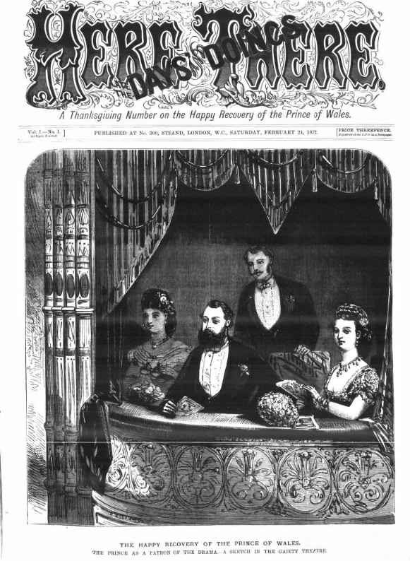
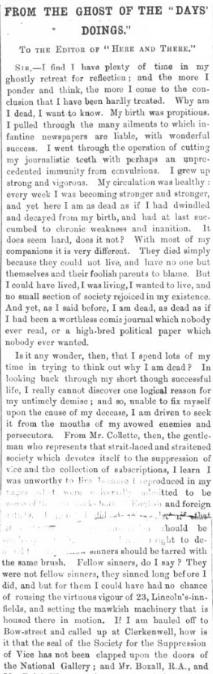
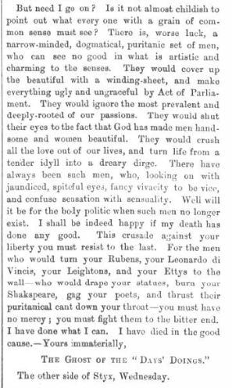
aftermath
Speaking from my own opinions of artistic matters, I utterly fail to see any illustration in our paper one whit an exaggeration upon what one actually sees in real life. In fact, after reading the morning papers, or looking into a photographic shop window, I have been astonished how tame our illustrations were.
The Days’ Doings 17/02/1872, p.2
Notes:
The conductor, whilst capitulating in court, took a very different approach in the paper itself. Under a column entitled ‘The Editor’s Protest’, the author makes a robust defence ‘against the late prosecution’ of the paper, suggesting its pictorial content was merely true to life and, compared to other sources, rather tame’ Actions, however, would speak louder than words. The paper underwent a change of title [click] to Here and There from the following week’s number, blaming the ‘spiteful prosecution’ by ‘a certain self-called society’ for creating ‘prejudice […] horror and disgust’ among potential readers. Although the content was markedly toned down, the link with the previous publication was retained in the form of the masthead and – more pertinently – in [click] a recurring feature ‘From the Ghost of the “Days’ Doings” complaining of the earlier title’s fate. There was little magnanimity in defeat being shown here!

Slide 18
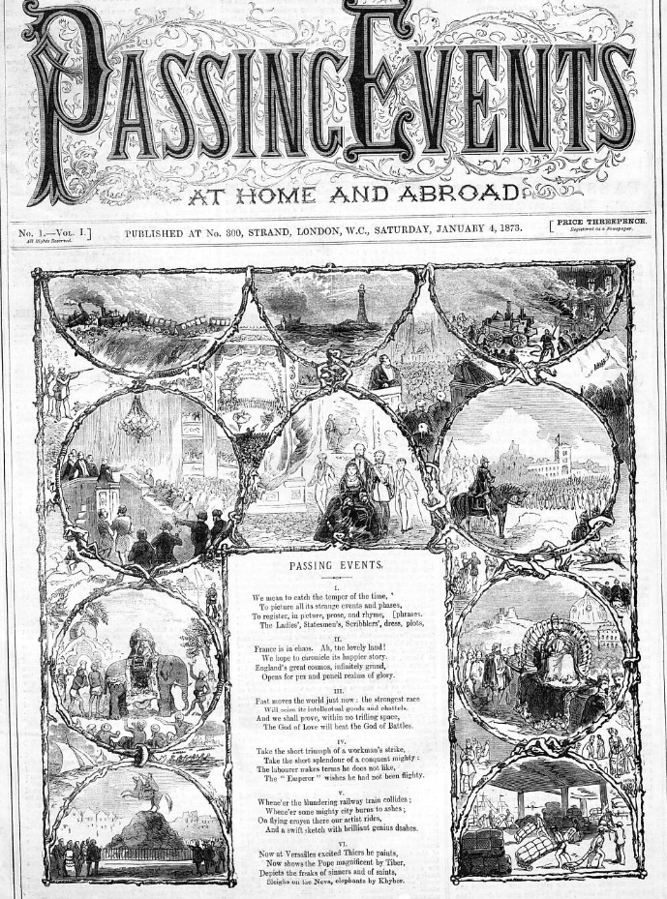
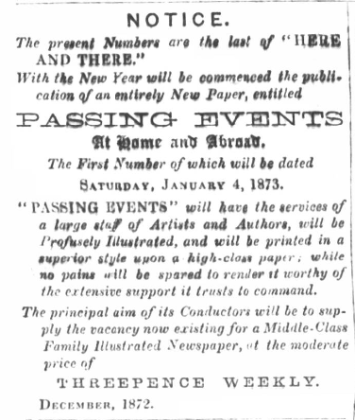
afterLife
Notes:
Here and There lasted the rest of 1872 but something had clearly been lost – probably lots of money. On 21st December 1872 – a year after the fateful Christmas special – this notice appeared [click]. From the same publishing address and at the same price, this was a noble attempt to launch a new title [click] utilising the artistic and journalistic resources in place. The illustrations now include many foreign landscapes rather than sensational or racy scenes. The etchings were well executed – but otherwise unremarkable. It was no surprise that Passing Events was very short-lived, lasting just thirteen weekly issues. For the Society for the Suppression of Vice, this was a notable scalp. For me, the joyful daring of the Days’ Doings deserved better than to end with such a whimper. But what effect did this have on the progenitor?

Slide 19
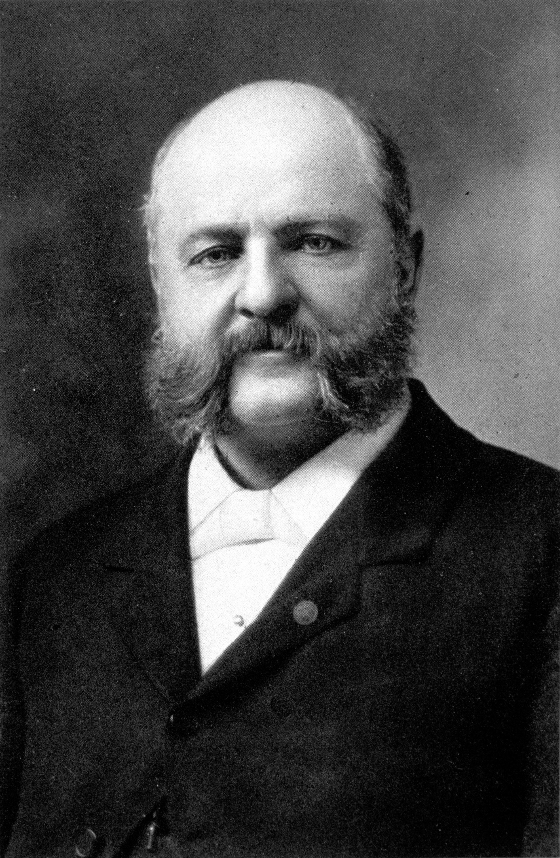
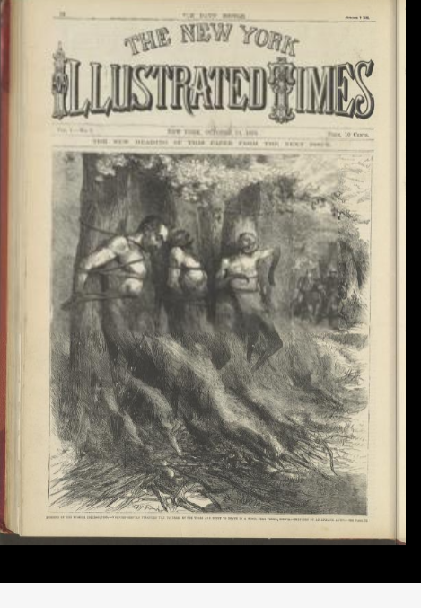
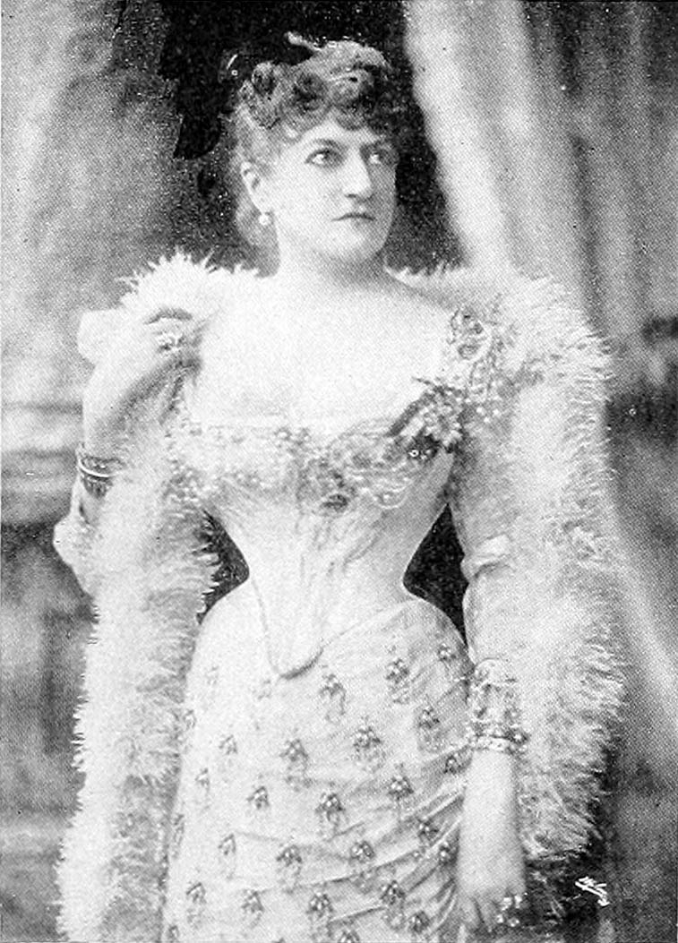
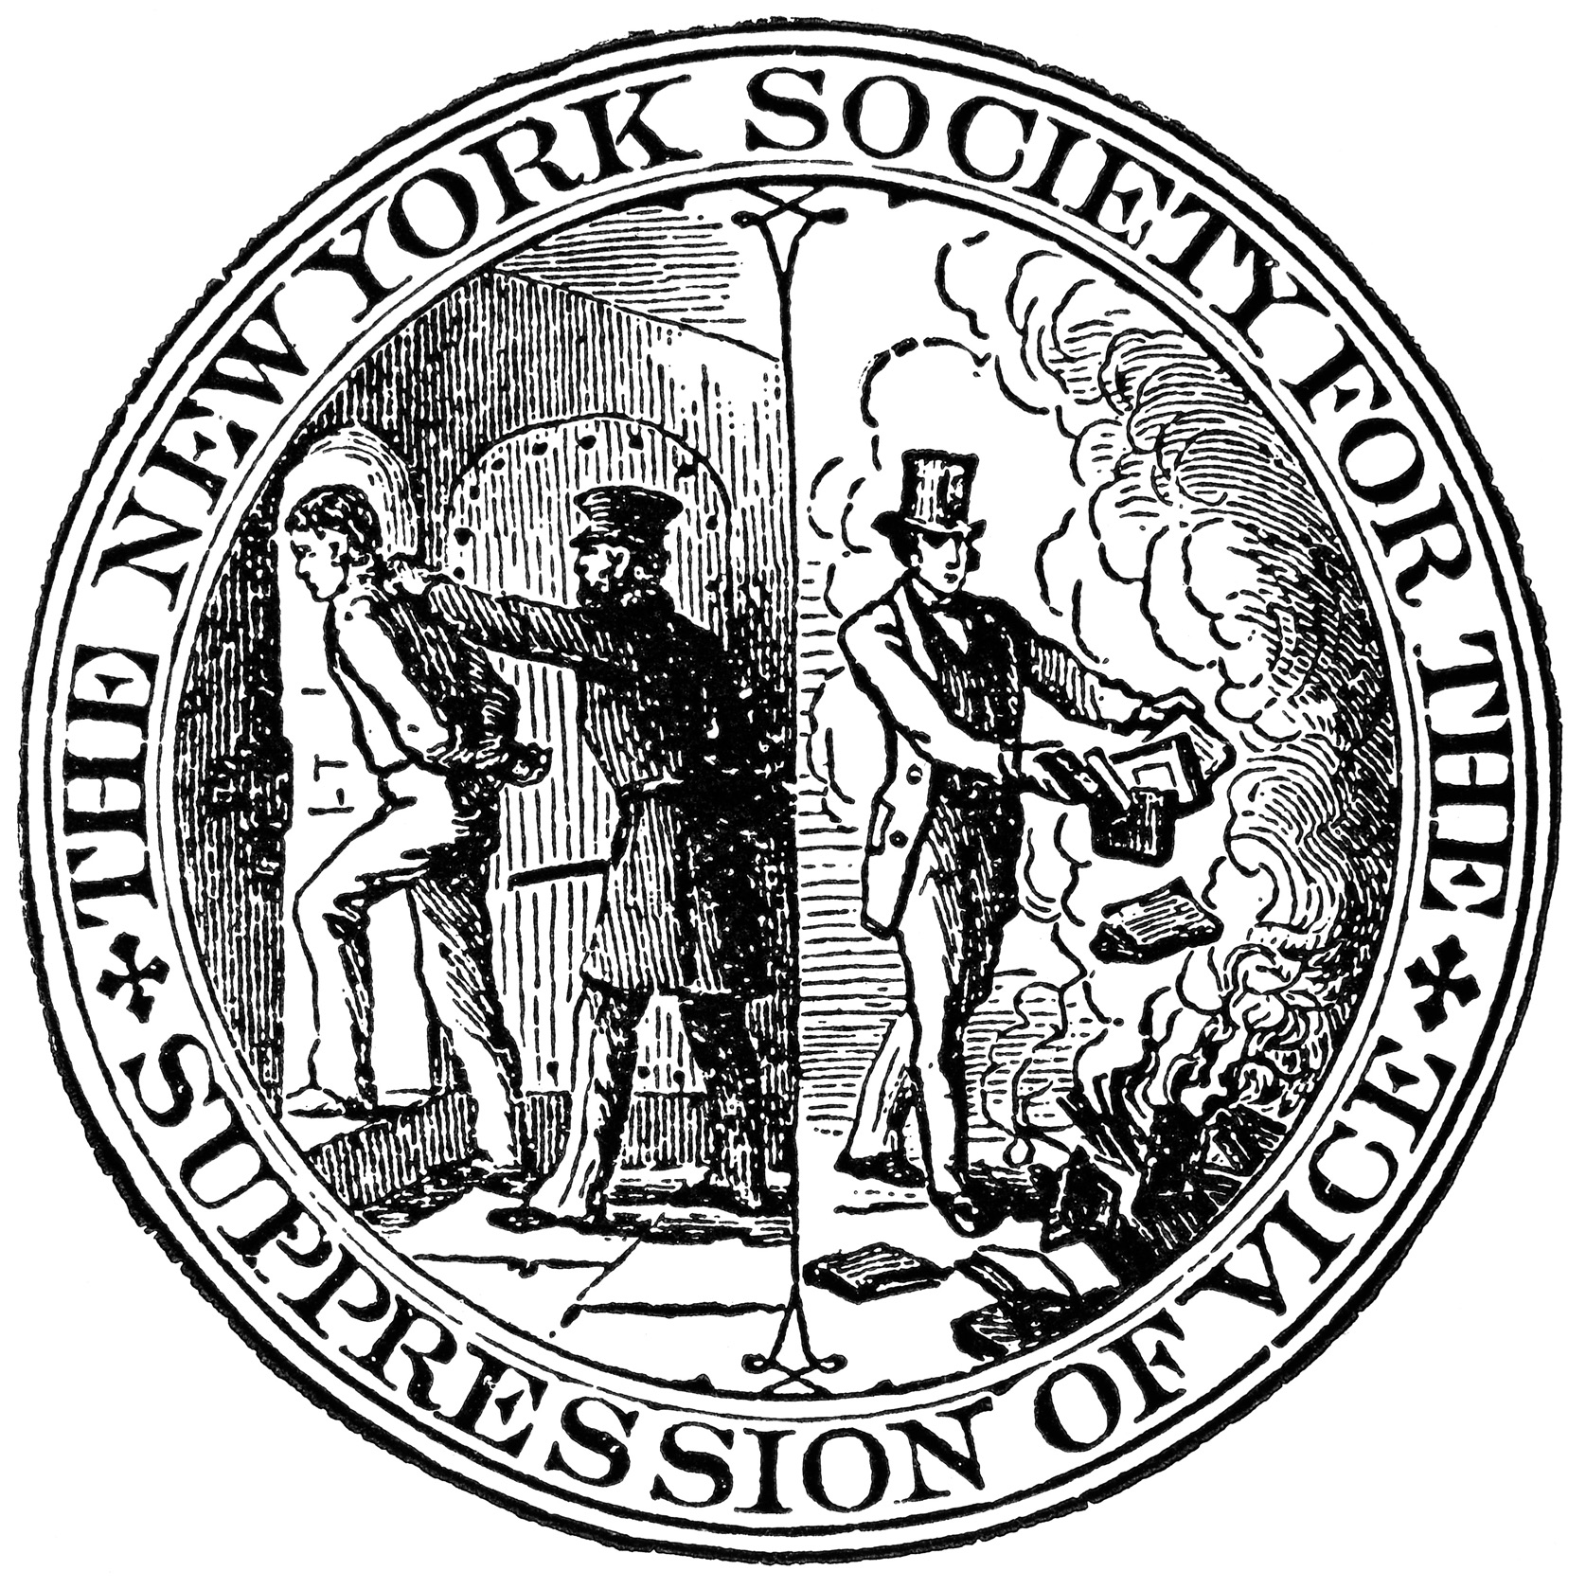
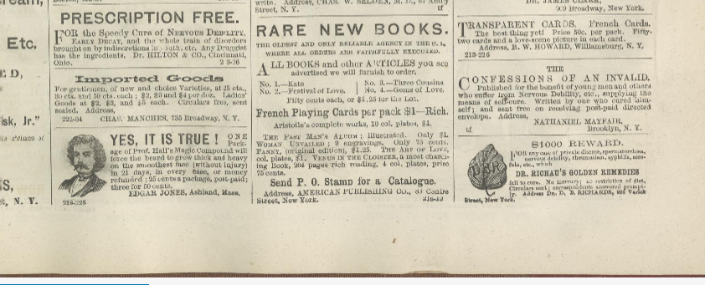
Meanwhile . . .
Anthony Comstock
A US Postal Inspector
Opposed to obscene literature, abortion, contraception, masturbation, gambling, prostitution and patent medicine
Anthony Comstock
Notes:
As the London paper was starting again with its third title in 1873, the Days’ Doings in New York also found itself pursued [click] by a moral crusader, Anthony Comstock, a US Postal Inspector dedicated to upholding Christian morality who was opposed to obscene literature, abortion, contraception, masturbation, gambling, prostitution and patent medicine. He would soon launch [click] the New York Society for the Suppression of Vice but, for now, took aim at the periodical, armed with an 1868 obscenity law and sponsorship from the Young Men’s Christian Association. Interestingly, ‘while he objected to the Days’ Doings’ illustrations, Comstock was especially incensed by the advertisements in the back pages [click] for ‘abortifacients and notices for “homosexual” illustrated books.’ [click] Here are some back page ads – there is perhaps a code at work. In any case Leslie, perhaps chastened by the experiences with the British courts, reached agreement with the public prosecutor to tone down the content of the publication, much to Comstock’s consternation. By 1876, the paper was rebranded to [click] to The New York Illustrated Times. In this guise, it continued until Leslie’s death in 1880. His widow, Miriam, [click] a four-times married feminist, found the paper offensive, even in its new form. She sold it to one William Ellis in 1881, who would sustain it for another four years.

Slide 20
answers
Who was responsible for the salacious publication that caused this localised moral panic?
What were the origins of The Days’ Doings?
What can be inferred about the motivations for launching AN American illustrated periodical in Britain?
To what extent did it succeed?
Notes:
For over fifteen years, then, a popular illustrated journal from the Frank Leslie stable was enjoyed by New Yorkers. It flirted with danger and challenged the moral consensus, but by adapting and possibly learning the lessons of its ill-fated British counterpart, was able to sustain for much longer. Whilst it’s not certain that Leslie was behind the London paper, evidence suggests he probably was. He had an instinct for targeting content to different sectors of the reading public, so it’s consistent with his practice that he might have done so across the Atlantic and really pushed the boundaries there. The migration of the Days Doings to Britain from Gilded Age New York was the act of a Transatlantic agent provocateur, a champion of freedom of expression, challenging the stifling public morality of mid-Victorian England. As such, I would argue that The Days’ Doings contributed to contemporary debates about the development of society, morality and the newspaper press itself, looking forward to more liberal times.

Slide 21
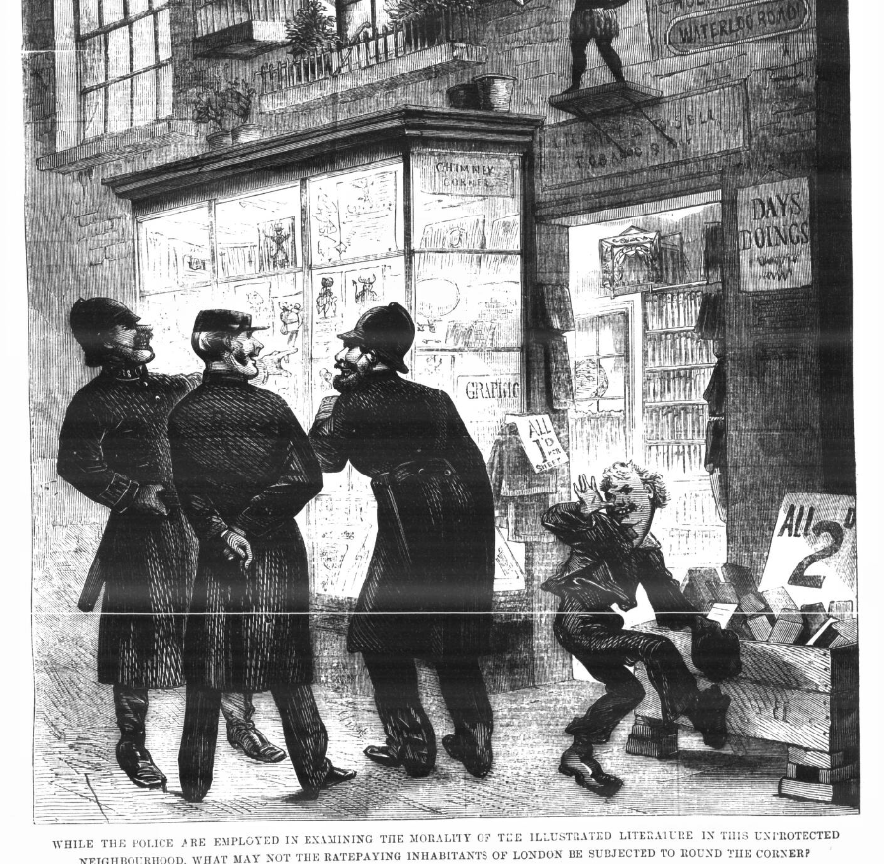

Thank you
Dr Matthew Stephens
Applied History Fellow
Institute of Historical Research, London
E: matthew.stephens1878@gmail.com
W: https://www.matthewstephens.org.uk
Bluesky: C19thnewshound@bskysocial.com
https://www.linkedin.com/in/
matthew-stephens-389070292/
Notes:
I close with the final illustration from the London Days’ Doings that hopefully speaks for itself. Thank you.

