Slide 1
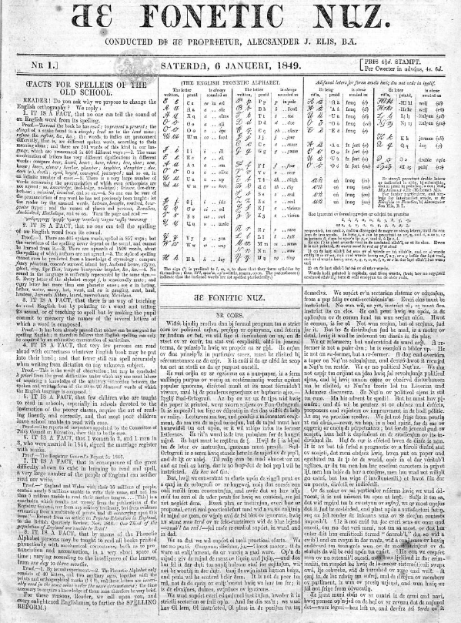
A brief spell of enthusiasm
The fonetic nuz and the vision of English spelling reform
Matthew Stephens
AHRC Collaborative Doctoral Partnership PhD student, 2021-25
Edge Hill University & British Library

Slide 2
Research questions
Was the short life of The Fonetic Nuz inevitable?
To what extent does The Fonetic Nuz - and the campaign it promoted – represent a failed vision?
Notes:
I’m going to be discussing today the brief printed life of the Fonetic Nuz, which was published from January to May 1849. To guide this presentation – and in keeping with the theme of this panel – I’m going to try to answer these two questions:
Was the short life of the Fonetic Nuz inevitable?
To what extent should it be considered representative of a failed vision?
The Fonetic Nuz, as we will see, was launched claiming to have found a way of addressing a key cause of illiteracy – the disconnect between spoken and written English. But how significant was illiteracy as problem in 1849?

Slide 3
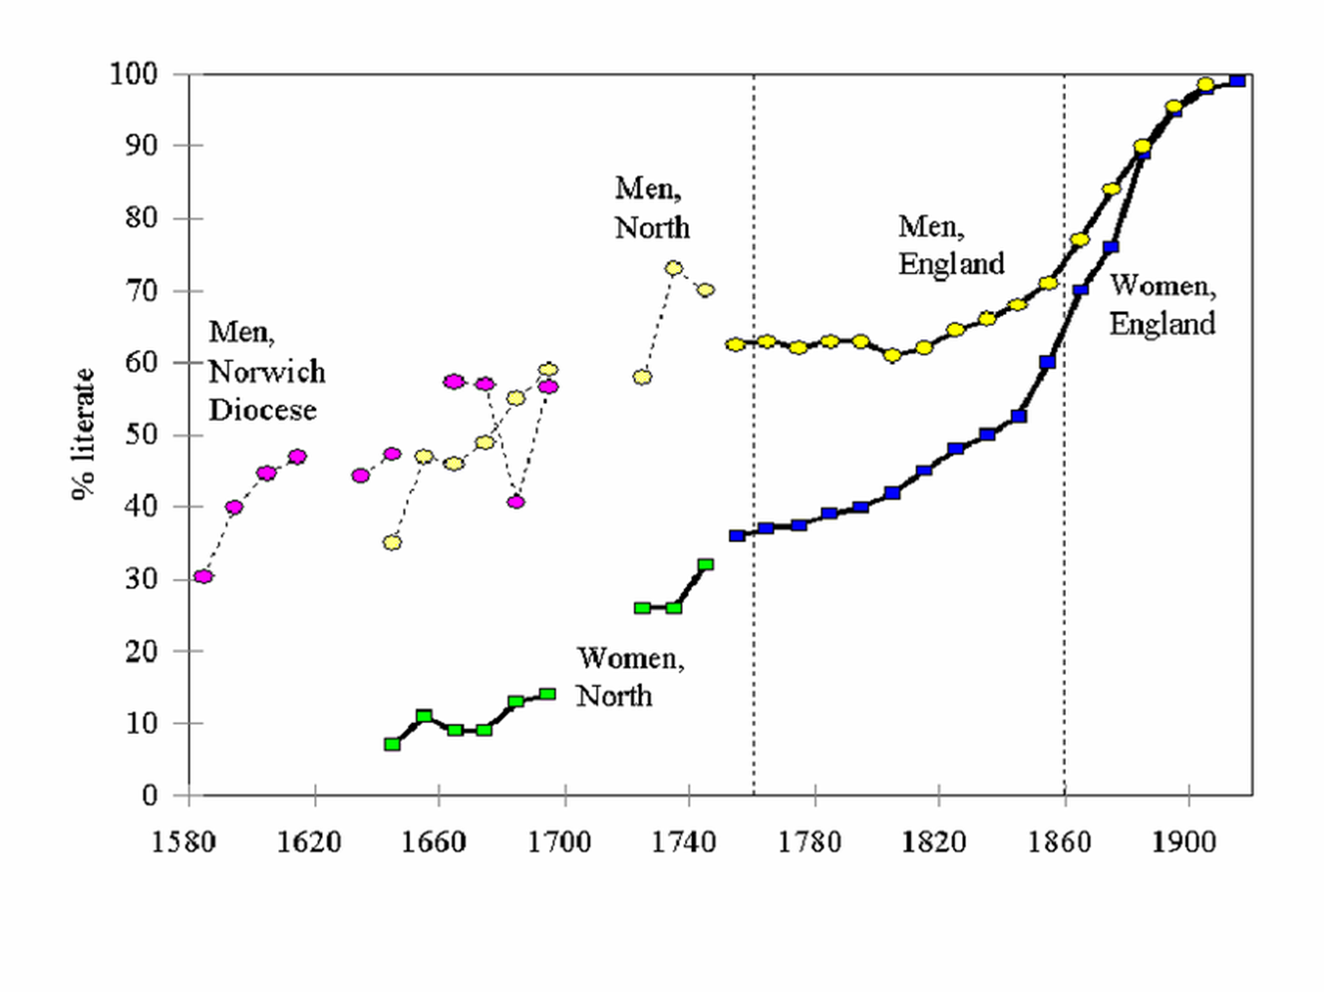
Literacy in Britain, 1800-1850 (England)
Male literacy 60-70% in period
(Female literacy lower)
Measured by ability to sign name
For most, literacy beyond this not necessary to life experience
Schooling provision through churches patchy
But illiteracy not a barrier to interest in e.g. political matters
Notes:
This graph demonstrates general literacy rates for males and females in England over time. Between 1800 and 1850, according to these measures, over 60% of men were literate. However, the standard measure of literacy was the ability to sign one’s name in the marriage register – hardly a reliable test as one can surely be taught by rote to draw a shape without comprehending its elements! Schooling was increasingly available but considered neither necessary nor, often, useful for the masses. The Establishment’s enduring fear of the mob meant that they were apprehensive lest the ability to read encouraged the dissemination of seditious literature. We know, of course, that illiteracy was no barrier to interest in social and political matters.

Slide 4
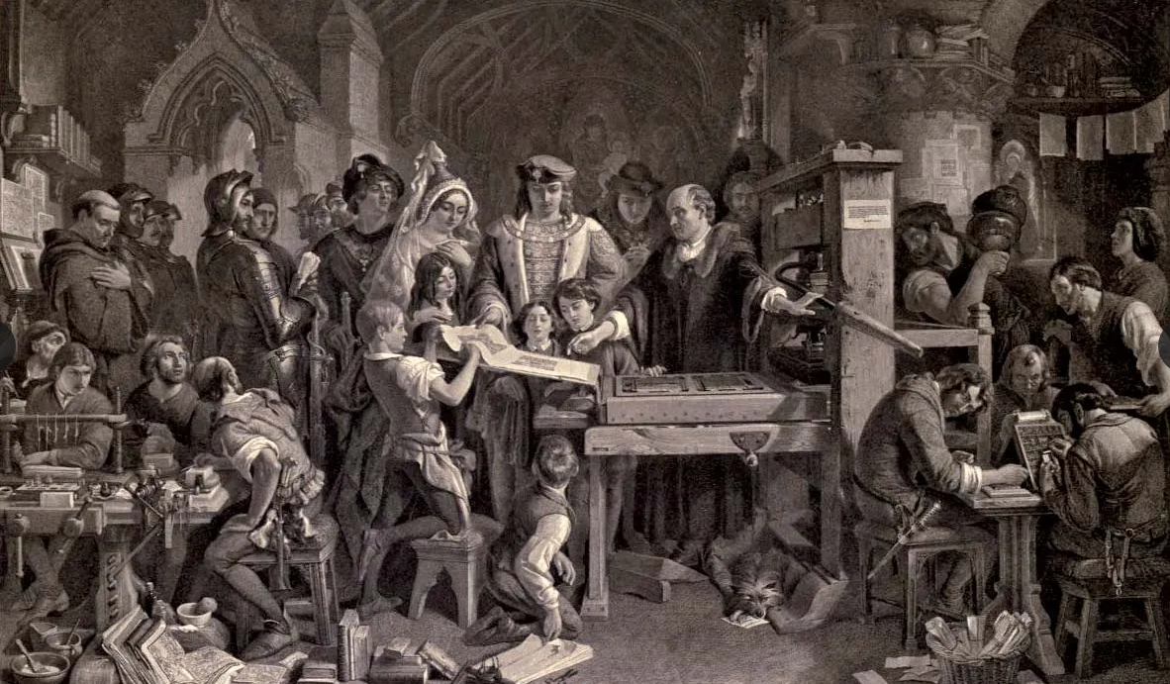

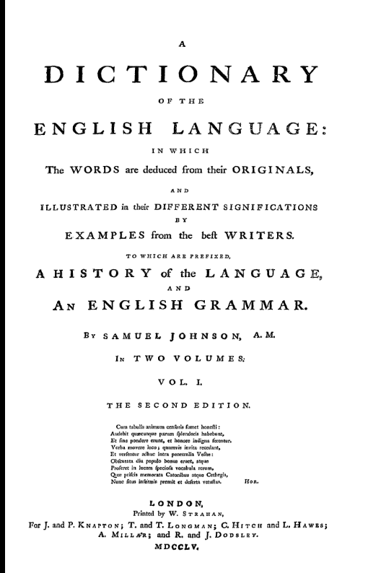
English spelling – origins of the problem
Caxton – choice to use Chancery English in first printed works. With variable spelling.
Dr Johnson’s Dictionary
Basis in etymology.
Increasing stability of orthographic forms
Notes:
Thinking about spelling itself begs the inevitable question: why is English spelling so odd? Something that probably every primary or Elementary school teacher is asked regularly! Of course, for most of its history there were few formal rules to govern English spelling – just look at any original-spelling edition of Shakespeare. However, printing technology did begin to demand a degree of standardisation. Once Caxton brought printing to Britain, he elected to print works using the Chancery English dialect, as that was the language of the courts and universities. This gave at least some limitations of variety of spelling, though anyone familiar with Chaucer’s work will remember plenty of variation. [CLICK] Later, Samuel Johnson’s Dictionary took an etymological approach [CLICK] and this partly explains the often archaic forms that have come down to us. [CLICK] By the nineteenth century, although spelling was still not entirely fixed (as fans of Jane Austen will know), there was an increasing stability in the use of orthographic forms – yet some significant people called into question how representative these written forms were of the living, spoken language.

Slide 5
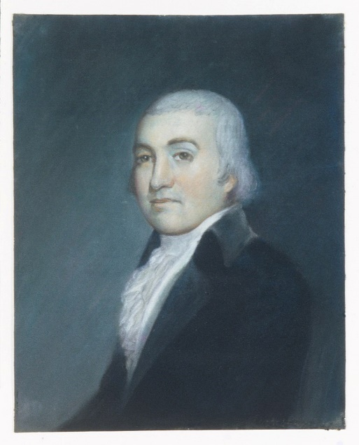
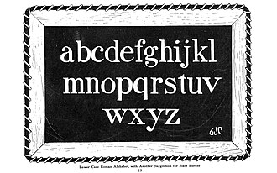
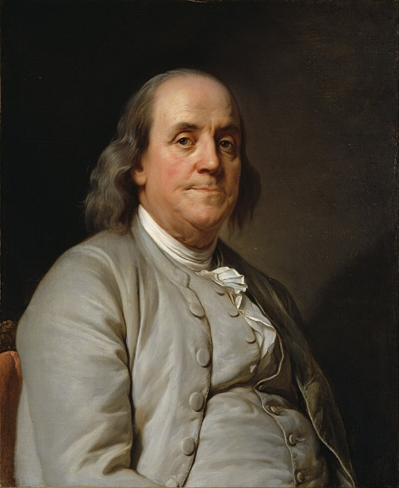
Spelling reform and some of its champions
Tension between spoken English – with around 44 phonemes – and written English using 26 letters.
Addressing this tension a concern especially in nascent United States in the 18th century
Benjamin Franklin – Scheme for a new alphabet (1768)
Noah Webster – A Grammatical Institute for the English Language (1783)
Notes:
English is not unique in having a tension between its natural spoken forms and the artificial code of its written forms but, with around 44 phonemes being represented by only 26 graphemes, it is certainly not one of the more phonetically written languages. [CLICK] Addressing this tension has concerned many through history. In the new world of the United States, two early exponents were [CLICK] founding father Benjamin Franklin – who privately devised a Scheme for a new alphabet in 1768 but was persuaded by friends not to pursue it – and Noah Webster, of dictionary fame. Webster, having started publishing on the language in 1783, maintained his interest despite the apparent indifference of contemporaries. In Britain, as might be expected, there was less impetus for drastic reform until, in the nineteenth century, two men would emerge and briefly combine in an attempt to shake the English language to its orthographic foundations.

Slide 6
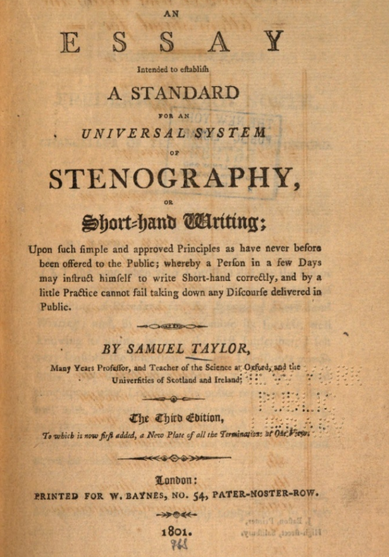
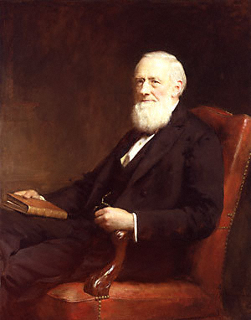
Representing the sound of English – Isaac pitman
Born in 1813, Wiltshire, England
Father well-read social reformer who helped to establish schools in Trowbridge.
Isaac educated in this way but also self-directed.
Trained as a teacher, ran schools in Lincolnshire and Gloucestershire from 1832.
Ascetic, religious man – drawn to Swedenborg
Developed Samuel Taylor’s earlier work on stenography for publication, encouraged by printer Samuel Bagster.
Notes:
The first of these was Isaac Pitman. [CLICK] He was born in 1813 in Wiltshire, [CLICK] to a father who was well-read and a social reformer who assisted in the establishment of local schools. [CLICK] Isaac’s education was partly in those schools, but he was also an autodidact, reading his way through his father’s library [CLICK] whilst training as a teacher and working in schools himself. [CLICK] A self-denying ascetic, he was teetotal, vegetarian and interested in mystical expressions of religion. [CLICK] He also became highly interested in updating Samuel Taylor’s 1786 Essay Intended to Establish a Standard for an Universal System of Stenography. Persuaded by printer Samuel Bagster that devising (or at least claiming to have devised) a new stenographic system would be better received, he did just that.

Slide 7
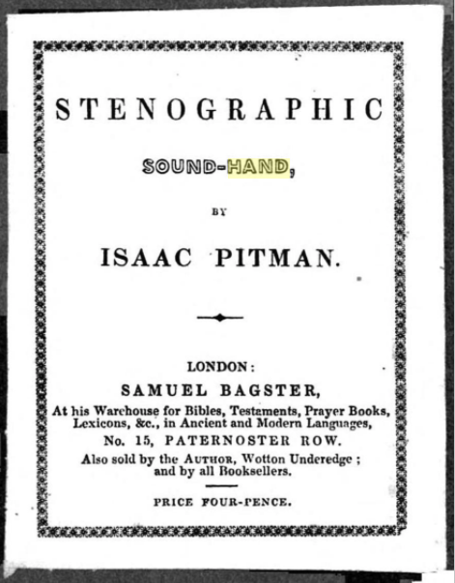
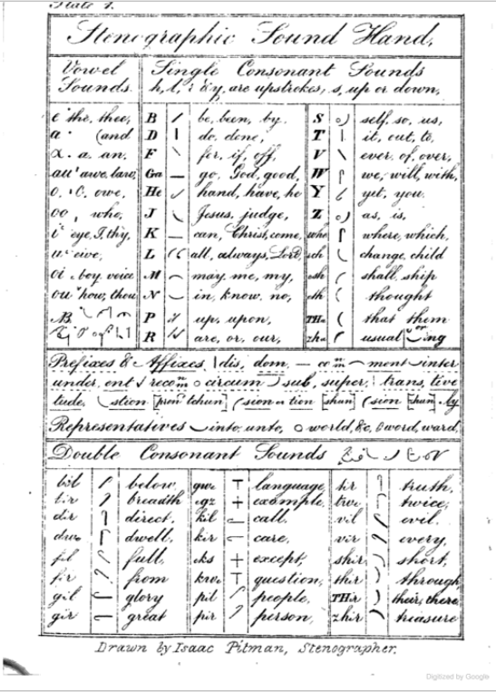
1837 – Stenographic Sound Hand pamphlet
Lines, hooks, circles for consonants
Dots, dashes, arrows for vowels.
A staging post – Pitman wanted his system to replace standard orthography.
Notes:
This is the system developed by Pitman as Stenographic Sound Hand – later known simply as shorthand and become a vital tool for many thousands of clerks, secretaries, stenographers and, of course, journalists. Before portable sound recording devices existed, this was a convenient way to record speech. Its origins are often attributed to Roman senator Cicero’s secretary Tiro, who developed a system to record his master’s speeches on wax tablets. Pitman’s system uses linear characters for consonants and a combination of letters and shapes for vowels. He didn’t intend it to be a separate system, but a staging post towards a different standard orthography.

Slide 8
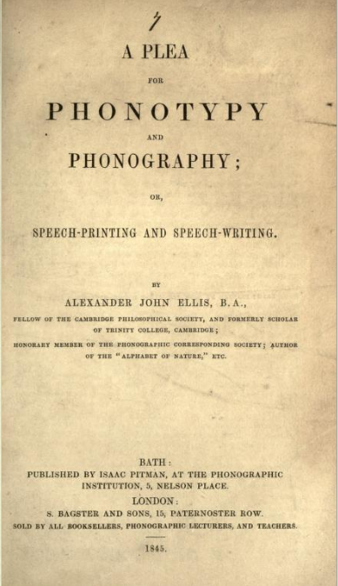
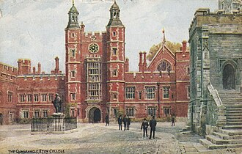

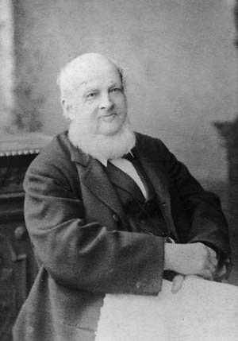
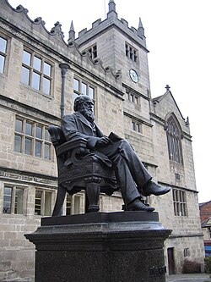
Representing the sound of English 2 – alexander ellis
Born 1814 as Alexander Sharpe in London
A schoolmaster relative granted him, at the age of 11, funds for his education and an income for life, conditional on adopting his mother’s maiden name.
Educated at:
Shrewsbury School
Eton College
Trinity College Cambridge
European travels – interest in sounds of language
On return, became aware of Pitman’s work and became involved…
Notes:
Almost an exact contemporary of Pitman, Ellis was born Alexander Sharpe in London, to what must have been a middle-class household, given that he attended a boarding school in Walthamstow until [CLICK] being offered – at age 11 and at the price of a change of surname – a lifetime without financial cares. Taking up this opportunity, he went firstly to [CLICK] Shrewsbury School, not long after its most famous alumnus, Charles Darwin. Thereafter he went to [CLICK] Eton and finally to [CLICK] Trinity College Cambridge – the college of another Isaac, Newton – where he excelled in mathematics and classics, graduating in 1837. [CLICK] He then embarked on a period of travel, especially in Italy, where he first became interested in the sounds and pronunciation of language. [CLICK] On his return to England, he became aware of Isaac Pitman’s work and they were soon corresponding. Ellis, despite his rather more privileged life, shared with Pitman a belief that conventional English spelling was a significant barrier to literacy. Ellis began by publishing a pamphlet, [CLICK] entitled A Plea for Phonotypy and Phonography in 1845, in which he applied his mathematical exactness to calculate, to absurd levels, the numbers of orthographic combinations possible for simple words. (He suggested that ‘scissors’ could be written over 58 million different ways!) Both men concluded that the development of a simplified, consistent system of orthographic representation could be achieved by adapting the phonetic systems of Pitman’s shorthand, and that this would enable the rapid spread of literacy. It’s a splendid theory until the practicalities have to be addressed! In this case, to render a new, more sound-based alphabet in print required the devising of new symbols (especially to represent vowels and diphthongs). Ellis’s comparative wealth enabled him to fund the production of new type founts, leading the two men to develop the ‘1847 Alphabet’, otherwise entitled confidently as the ‘English Phonetic Alphabet’. Although today Pitman is remembered more readily than Ellis, the latter has been the subject of a least one PhD thesis, by a Canadian scholar in the 1970s. [CLICK] Let’s have a look at the 1847 Alphabet.

Slide 9
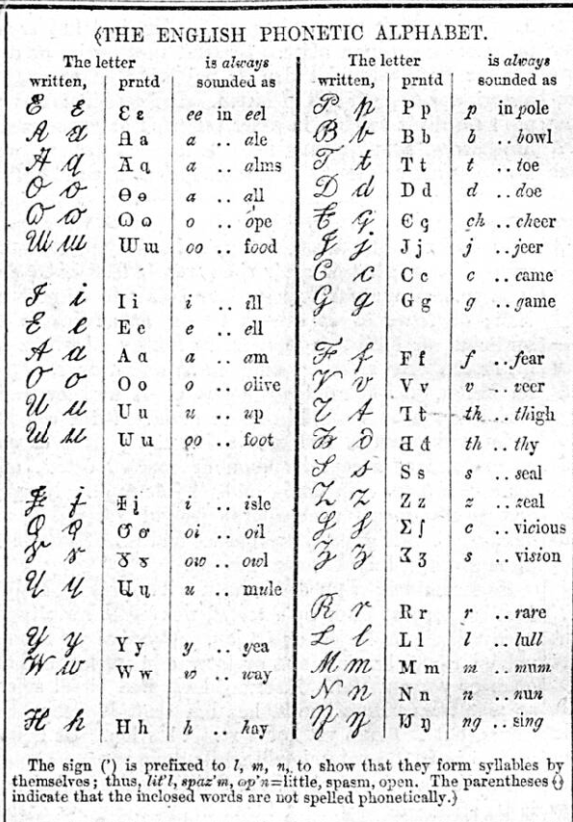
The (1847) english phonetic alphabet
A compromise between standard orthography and phonetic notation
40 characters
Symbols for many consonants used in IPA today, incl.
ð - eth (voiced dental fricative)
ŋ - eng (voiced velar nasal)
ʃ (voiceless postalveolar fricative)
ʒ (voiced postalveolar fricative)
Vowel representation more complex - one of the symbols in Ellis’s alphabet remains -
ɯ (close back unrounded vowel).
Notes:
Here it is. [CLICK] In recognition of the need for a degree of familiarity, it is much closer to standard orthography that Pitman’s Sound Hand. [CLICK] It uses 40 characters. Most of the consonants are as they appear in the Roman alphabet. [CLICK] Some others appearing here – not necessarily for the first time – are still used today in the International Phonetic Alphabet, [CLICK] including eth – as in ‘there’, [CLICK] eng as in ‘thing’ [CLICK] and the postalveolar fricatives found in ‘should’ and ‘vision’. [CLICK] As I note here, the real problem is in representing vowels and diphthongs. Interestingly, the examples given here take no account of differences of accent – ‘owl’, for instance, can sound very different in Kent (owl) and Tyneside (owl)! But as a practical introduction, it largely works. Although afterwards the two men began to diverge in their view of refinements, it was largely this alphabet which was used to promote the cause more widely, including in the newspaper publication which was launched by Ellis in 1849 to demonstrate the system practically – the Fonetic Nuz. Let’s see the alphabet in use in that newspaper.

Slide 10
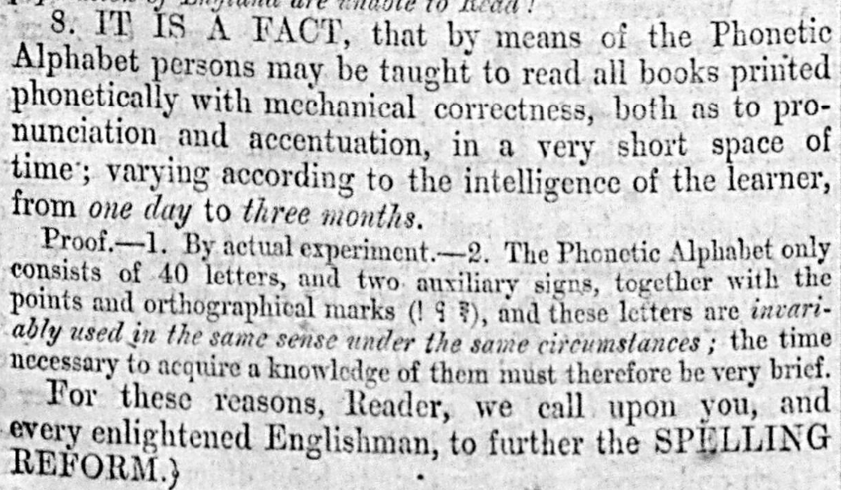
The fonetic nuz
Practical demonstration of Ellis’s vision
Notes:
In this demonstration of his theory, which was a Saturday weekly paper selling for four and a half pence, Ellis made a number of bold claims, including stating[CLICK] that: ‘IT IS A FACT, that by means of the Phonetic Alphabet persons may be taught to read all books printed phonetically with mechanical correctness, both as to pronunciation and accentuation, in a very short space of time; varying according to the intelligence of the learner, from one day to three months.’ […] For these reasons, Reader, we call upon you, and every enlightened Englishman, to further the SPELLING REFORM.’ There is no evidence offered to verify his assertions; though they do say that press statements are not given under oath…

Slide 11
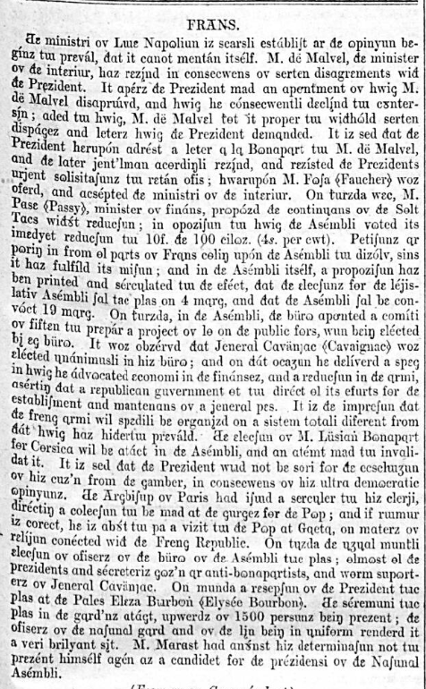
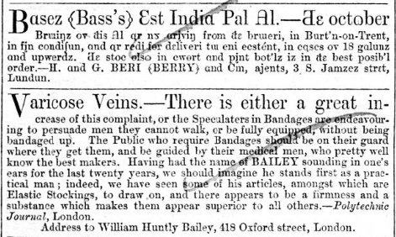
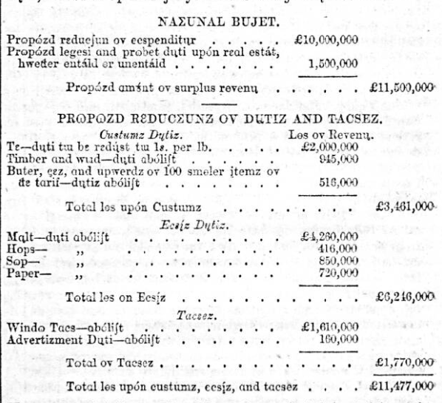
The fonetic nuz
Content of a conventional newspaper as well as on own subject
Adverts in both phonetic and conventional orthography
Notes:
Aside from its campaigning matter, the paper covered more conventional matter, including foreign news – here is an example of a report on the situation in France – [CLICK] and Parliamentary items, such as this on Cobden’s proposal for a National Budget. As educated, literate people, we can decode it without too much difficulty; but I’d love to be able to ask Ellis why this orthographic presentation made it more readily accessible to the illiterate. [CLICK] Adverts were presented in both conventional and phonetic orthography, as in this example.

Slide 12
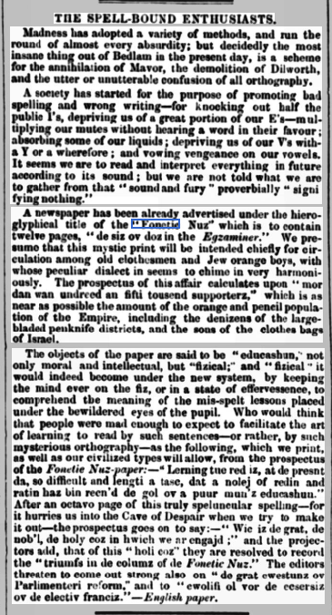
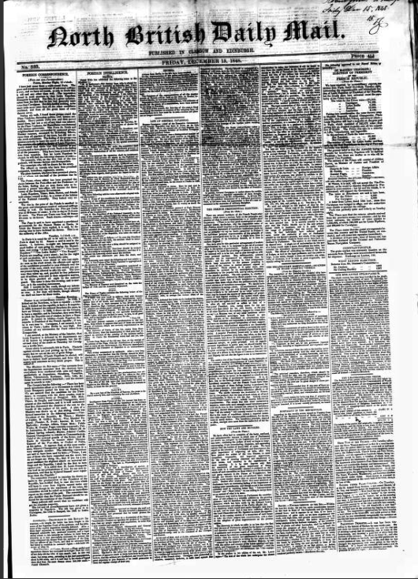
Reception of the fonetic nuz
Notes:
The North British Daily Mail, reviewing an advance copy, offered a typical response to Ellis’s innovation on 15th December 1848.

Slide 13
Notes:
‘Madness has adopted a variety of methods’, it says. The idea is ‘the most insane thing out of Bedlam’ which rejects all the conventions of respected grammarians. One wonders if Ellis was braced for such a sneering response to his idealistic vision.

Slide 14
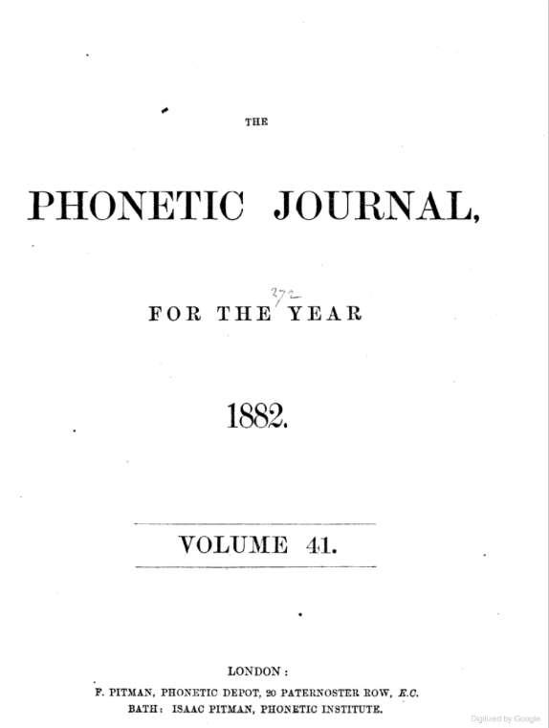
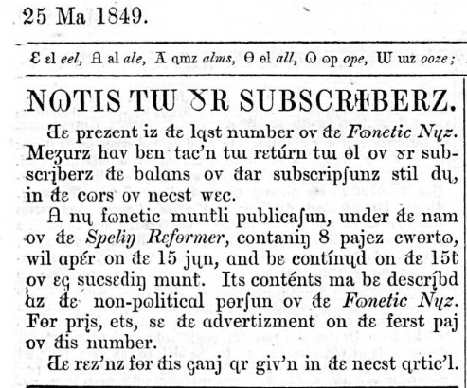
The end of the fonetic nuz
Fonetic Correspondent (1848)
Spelling Reformer (1849)
Fonetic Almanac (1852-3)
Notes:
After just five months, Alexander Ellis called time on the newspaper, announcing it with this notice. [CLICK] The subsequent, longer piece in the paper details the economics involved, noting that ‘it would require a sale of 9,000 copies to repay the outlay’. Such sales are admitted to be unachievable at that time. However, Ellis states that ‘we can look back on the published numbers of the Fonetic Nuz with satisfaction; but the number of persons yet interested in the Reform who can or will purchase a newspaper is too limited to meet the great outlay…We must own that the publication of the Fonetic Nuz has been premature.’ [CLICK] The Nuz was not the only publication around this time championing Spelling Reform. The Waterloo Directory has entries for a Fonetic Correspondent (1848) and a Fonetic Almanac (1852-3). As the dates suggest, neither made a lasting impression. Ellis’s own successor title, Spelling Reformer, was launched as a monthly periodical in June 1849 and sustained for only eight issues. Britain was not yet ready to embrace a new Phonetic Alphabet. Ellis apparently had sufficient acumen to know when he was beaten. Rather more enduring in terms of the general interest was the Phonographic Journal launched by Pitman in 1843, which experienced several title changes before settling on the Fonetic Jurnal in 1851 and continuing for much longer. [CLICK] Here’s the volume title page from 1882 which, interestingly, affects standard orthography!

Slide 15
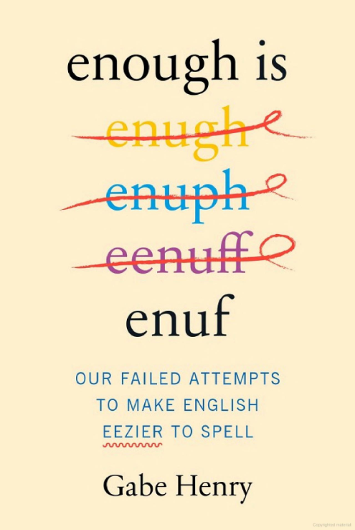


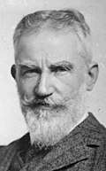
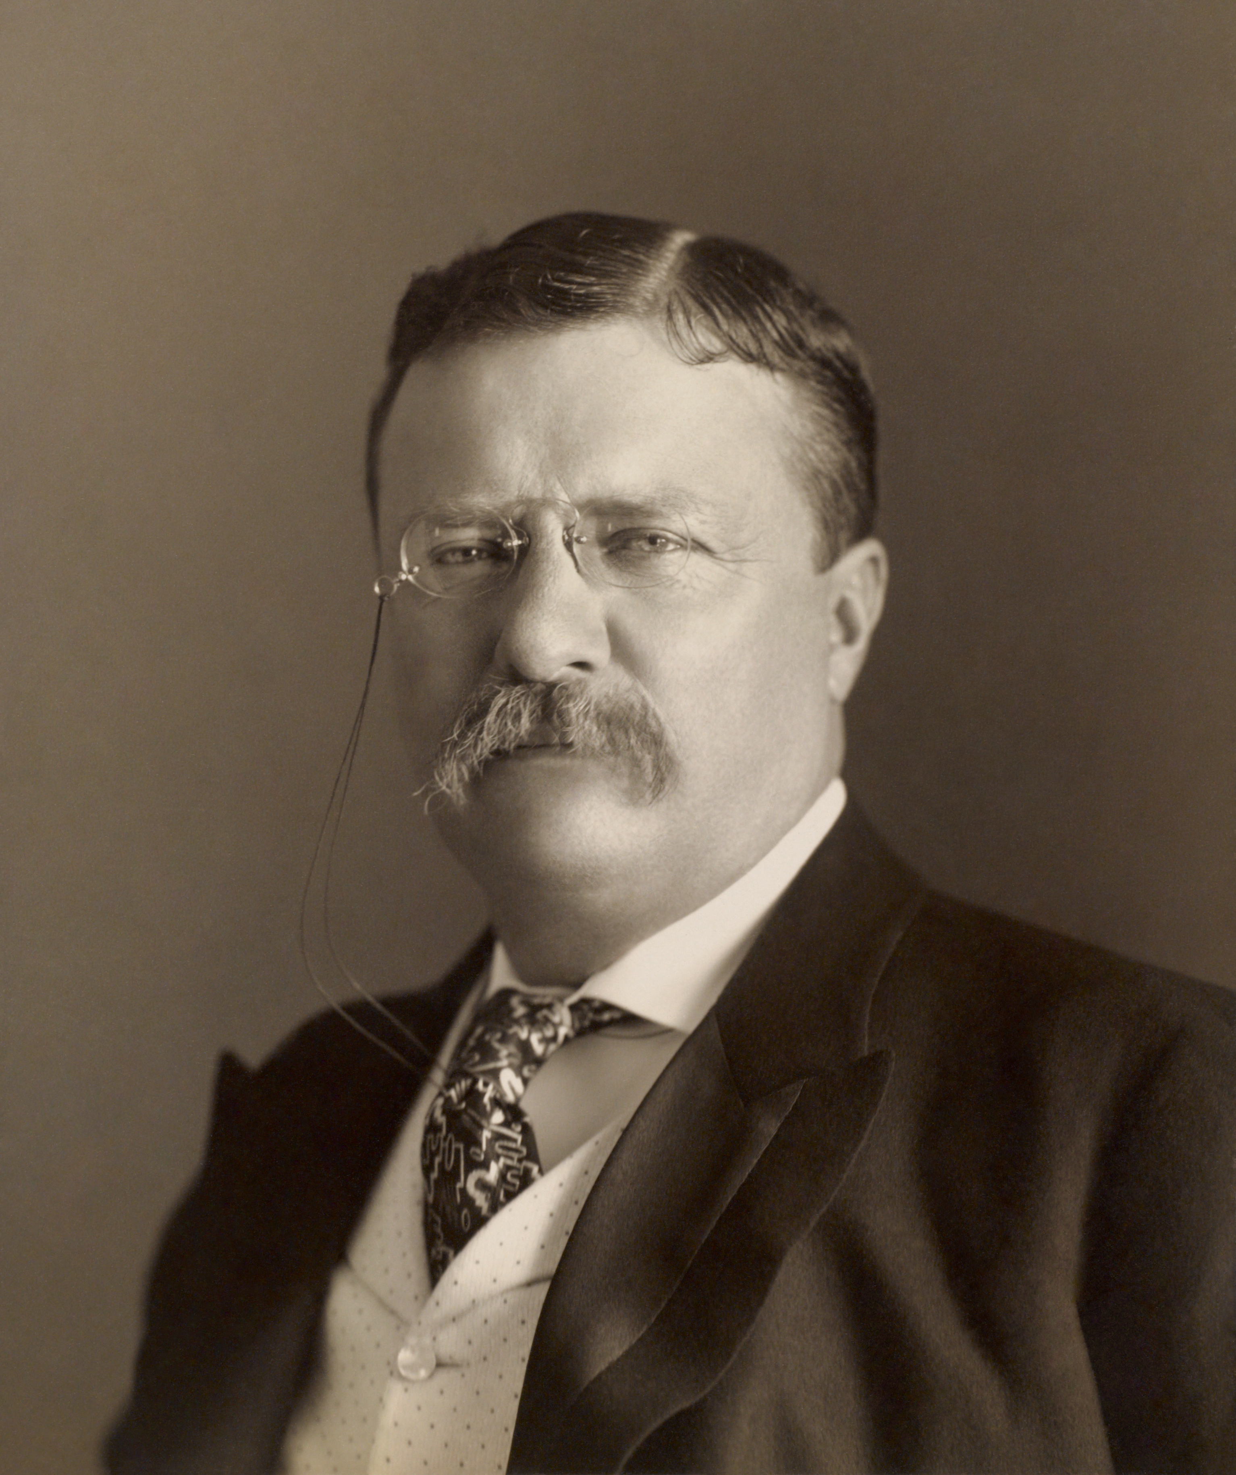
Legacies of the 19th century spelling reform movement
Science of Phonetics & IPA
Phonics as a teaching method
The Spelling Experimenter and Phonetic Investigator (1880-1883)
Spelling Reformer and Journal of the English Spelling Reform Association (1880-1881)
English Spelling Society (originally the Simplified Spelling Society from 1908).
Simplified Spelling Board (1906)
Implemented changes to US spelling in use today.
Notes:
Ellis conceded that his idea was ahead of its time, [CLICK] yet spelling reform as an idea resurfaced again in 1880 in Britain, when two new publications appeared. One was The Spelling Experimenter and Phonetic Investigator, published by Pitman (him again) until 1883; and the English Spelling Reform Association’s own publication, pithily entitled Spelling Reformer and Journal of the English Spelling Reform Association, which appeared between 1880 and 1881. [CLICK] In the twentieth century, simplified spelling was pursued on both sides of the Atlantic, with more obvious effect in the English of the United States than in Britain. A key supporter of reform in Britain was [CLICK] author George Bernard Shaw, whereas in the USA [CLICK] Theodore Roosevelt championed the work of the Simplified Spelling Board, an organisation supported financially by steel magnate Andrew Carnegie. In terms of broader legacy, [CLICK] both the science of phonetics and the use of phonics in the early stages of literacy acquisition all had roots in these earlier campaigns. And I heartily recommend [CLICK] this new work as an entertaining summary of the history of spelling reform. (Thanks to Linda for pointing me to that one!)

Slide 16
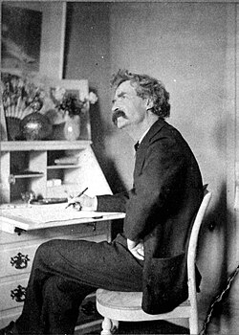
Visions of failure?
Was the short life of The Fonetic Nuz inevitable?
To what extent should it be considered a failed vision?
‘Simplified spelling is all right, but, like chastity, you can carry it too far.’
Mark Twain
Notes:
So, was the short life of the Fonetic Nuz inevitable? In retrospect, yes. Ellis was testing a personal belief that an alphabet based on a more direct relationship between phoneme and grapheme would improve literacy. Beyond its stated purpose as a practical demonstration of the new alphabet, the price of the Nuz meant that it was unlikely to attract those would-be readers to it and would rather be a curiosity piece for already interested parties. [CLICK] Was it, then, a failure? Not according to Ellis, who claimed, ‘It has been far from being a failure; on the contrary, it has been very successful in raising the sympathies of friends, in extending an knowledge of the Reform into quarters where it would have been otherwise scarcely known, and in giving it a reality in the minds of men.’ This seems a reasonable claim; It can be said to have been a successful practical demonstration in printing with a Phonetic Alphabet and it played a part in raising awareness of the general Spelling Reform campaign. I would argue that the Fonetic Nuz stands as a record of an experiment in reform that was sincerely intended to be of benefit to all – a laudable instance of Victorian paternalism if, ultimately, an unachievable aim. The reason for this is probably best expressed [CLICK] by sometime reform enthusiast Mark Twain, who concluded: ‘Simplified spelling is all right, but, like chastity, you can carry it too far.’

Slide 17
Thank you
Email 1: 23715162@edghill.ac.uk Email 2: Matthew.Stephens@bl.uk
Website: https://www.matthewstephens.org.uk
BlueSky: @c19thnewshound@bskysocial.com
LinkedIn: https://www.linkedin.com/in/matthew-stephens-389070292/

