Slide 1
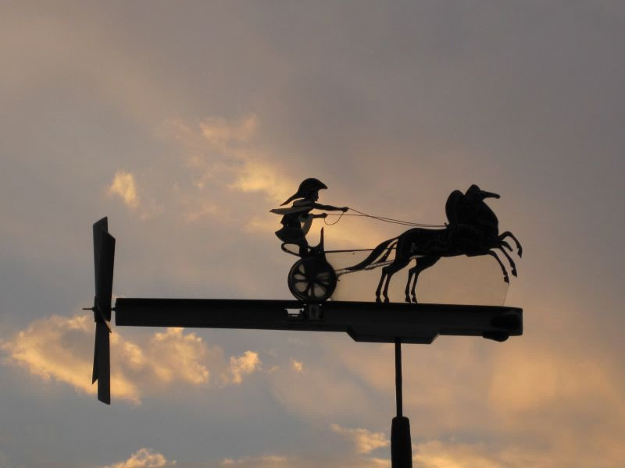
An ill wind from the west: The role of America in the fate of the illustrated news of the world, 1858-1863
Matthew Stephens
AHRC Collaborative Doctoral Partnership PhD candidate
Edge Hill University & British Library
Notes:
I’m going to be looking at the short-lived newspaper the Illustrated News of the World today, focusing in particular on the role played at various times in its short life story by events in America. My PhD research aims to challenge the assumption that all short-lived newspapers in the nineteenth century were de facto failures. My work is uncovering a number of examples that cast more light on the plethora of reasons why so many newspapers ceased publication after a relatively short span. These question the conventional truism that the primary marker of success for a newspaper in the century was a long life in print. The Illustrated News of the World is very much a case in point.

Slide 2
Teething troubles
‘The late 1850s and the first half of the 1860s were a volatile time for local newspapers, as many new entrants joined – and left – the market and experimented with new formats and publishing models. Throughout the nineteenth century, but particularly at this time, the most common business model for a newspaper was to launch with too little capital, lose a great deal of money and then fold in a matter of weeks.’
Andrew Hobbs, A Fleet Street in Every Town: The Provincial Press in England, 1855-1900, drawing on
Martin Hewitt, The Dawn of the Cheap Press in Victorian Britain: The End of the ‘Taxes on Knowledge’, 1849-1869
Notes:
There are, of course, many examples of newspapers being launched that were undercapitalised and incompetently managed, with little mystery or nuance surrounding their brief existence. Andrew Hobbs states the case succinctly here, saying: Throughout the nineteenth century, but particularly at this time, [around 1855] the most common business model for a newspaper was to launch with too little capital, lose a great deal of money and then fold in a matter of weeks. There are some notable exceptions to this model, however, even amongst short-lived newspapers.

Slide 3
Brevity = failure?
Definition does hold in many instances.
Individual or collective failure?
Exceptions challenge the automatic presumption
QUESTIONS
What was unusual about the circumstances around the birth of the Illustrated News of the World?
What part did events in the USA play in its entrance and eventual fate?
How does this analysis help to problematize the assumption of failure?
Notes:
Having conceded that Hobbs’ definition is often an accurate summary, there are alternative perspectives. [CLICK] It can be argued that any endeavour with a very high failure rate suggests that the ‘failure’ is structural rather than individual, indicative of a market that tends to support cartels rather than competitive multiplicity. The development of the press from a relatively small-scale artisanal endeavour into a mass-market, free-market industry over the century naturally came with significant collateral damage; [CLICK] so to categorise every short-lived paper as a failure disregards particular contexts and circumstances in which, with hindsight, a more subtle interpretation of their place in the history of the press can be offered. [CLICK]
To this end, I am today going to explore the following questions: [CLICK] what was unusual about the circumstances of around the birth of the Illustrated News of the World; [CLICK] and what was the impact of events in the United States at key points in the paper’s story. [CLICK] This analysis will support my argument that the paper ought not be dismissed peremptorily as a failure.

Slide 4
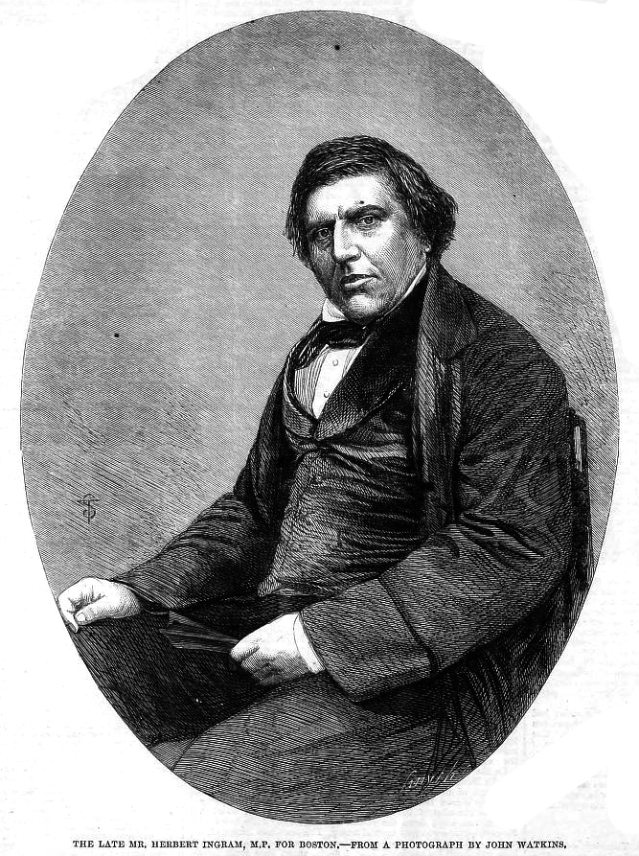
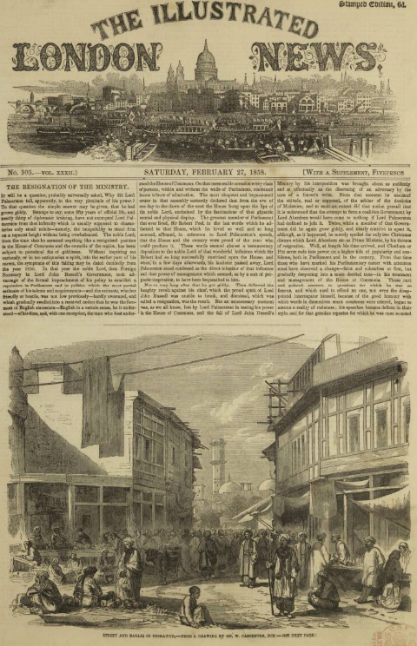
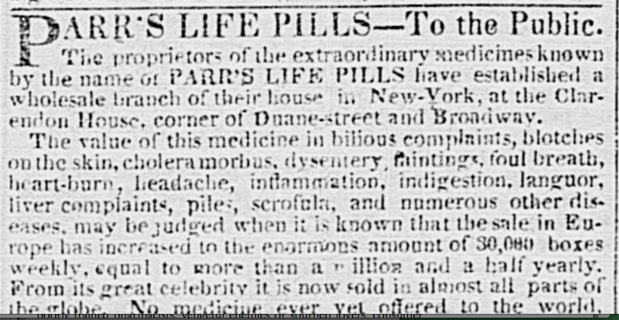
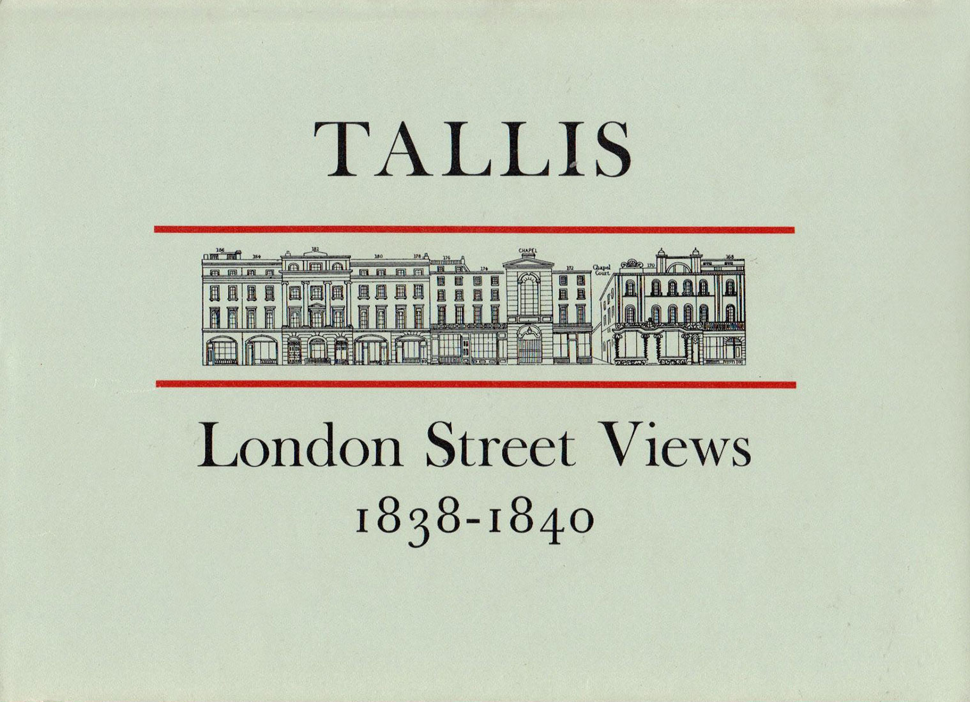
A tale of two egos
Herbert Ingram 1811-1860
John Tallis II 1817-1876
Notes:
The origin of the Illustrated News of the World may be described as a tale of two egos - a rivalry between [CLICK] Herbert Ingram, the celebrated, if morally suspect founder of [CLICK] the Illustrated London News, and [CLICK] John Tallis. There are competing accounts of dealings between these two, but both were highly ambitious, self-confident men of their age. Ingram, a butcher’s son who trained as a printer, made a fortune peddling [CLICK] a quack remedy to fund his newspaper ambitions. Tallis was the son of a printer and bookseller; the family stock in trade was maps and street views, sold in volumes and parts. [CLICK] London Street Views was the Google streetmaps of its day!

Slide 5
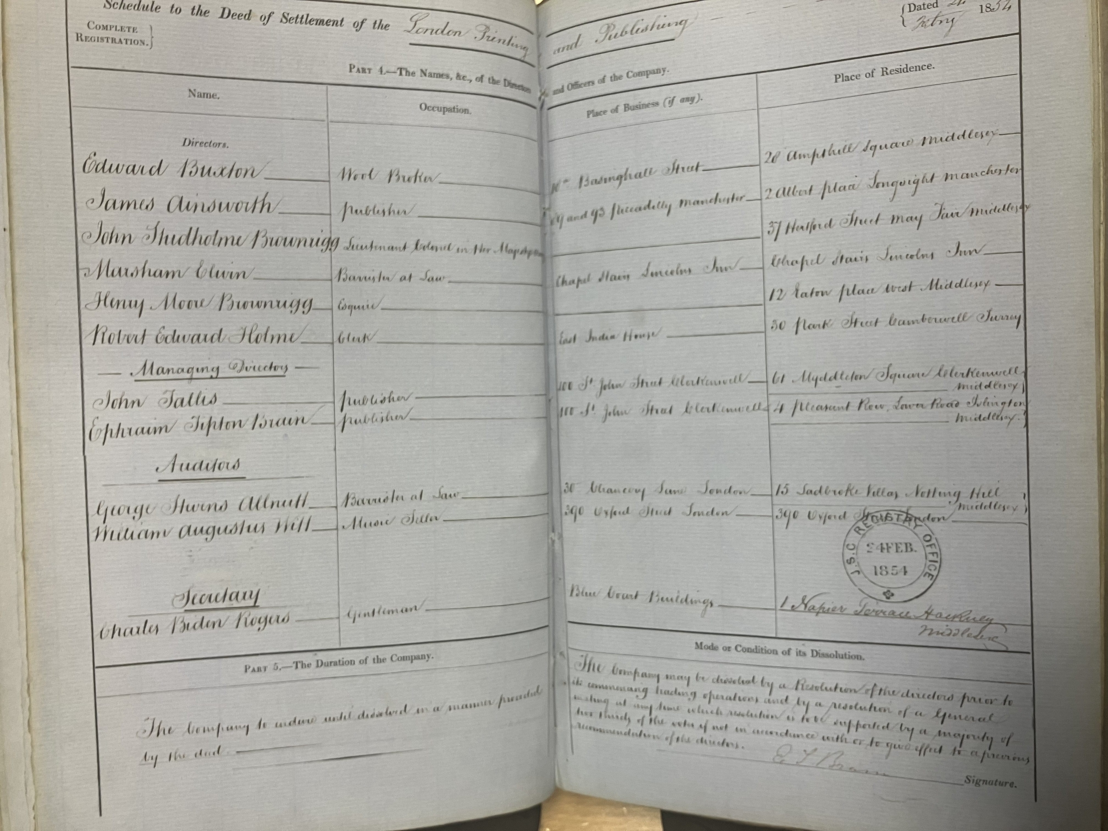
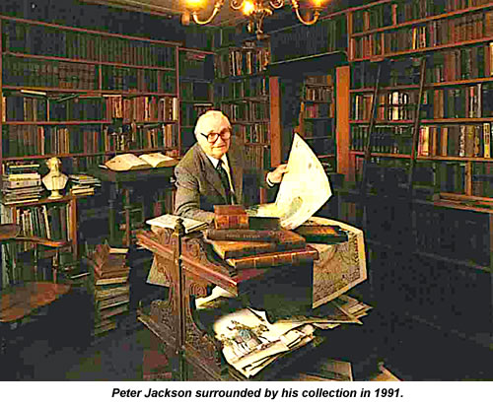
TO BUY, OR NOT TO BUY
1854 – registered the London Printing & Publishing Company
1857 – offers £150,000 for the Illustrated London News.
The launch of the Illustrated News of the World was trailed widely in the press from the end of May 1857.
The London Printing and Publishing Company initially backed the new venture.
Notes:
1854 saw Tallis form the London Printing and Publishing Company, with nominal capital of £200,000. The legal framework around limited liability companies developed markedly during the 1840s and 50s, so this company represented a bold step into the most modern form of business. Its nominal capital would equate at least £20m today – on some measures, ten times that figure. The first year’s share issues, involving some twenty-nine individual shareholders and a consortium of three, held just over 19,000 of the nominal 40,000 shares. Tallis owned 12.5% of the company and received a payment £25,000 for his stock, plant, copyrights and goodwill. [CLICK]
In 1857, Tallis apparently attempted to buy the Illustrated London News from Ingram for £150,000. The closest to a primary source for this story comes from [CLICK] twentieth-century illustrator and scholar Peter Jackson, pictured here, who claimed to have retold Tallis’s own version of this story, in his introduction to the 1969 reissue of Tallis’s London Street Views. Jackson was fortunate to have had access to John Tallis’s own papers through his grandson Eric. In this account, Ingram initially agreed to sell but soon after reneged on the deal. Tallis then registered his own new title with the Stationers’ Company that day. As noted here though, [CLICK] the new title was being advertised widely from May 1857 as a ‘coming soon’ teaser. Such deliberate advance marketing is at odds with the narrative of a hasty retaliatory action. [CLICK] What is essential is to note that, initially, the company was entirely supportive of the intended new title.

Slide 6
Cold feet
January 1858: shareholders of the London Printing & Publishing Company withdrew support for the Illustrated News of the World. (Jackson)
The home-grown ‘panic’ of 1857
Short-lived – NYC banks suspended October 13th, resumed operations December 11th.
Very few bank failures (19/258 in New York)
Origins?
Notes:
In January 1858, Tallis’s fellow shareholders suddenly seem to have got cold feet about the imminent newspaper and withdrew support for it, freezing his shares and denying him use of company assets. The reason or excuse given was a recent financial panic in the USA. [CLICK]
This ‘panic’ of 1857 was the first home-grown American financial panic, i.e. not caused by war or international financial adjustments. [CLICK] It principally affected banks on the east coast, was of a few months’ duration and, in relative terms, hardly catastrophic, [CLICK] with very few banks ultimately failing.
[CLICK] So, what caused this ‘panic’ and what effect might it have had on a publishing company across the Atlantic in London?

Slide 7
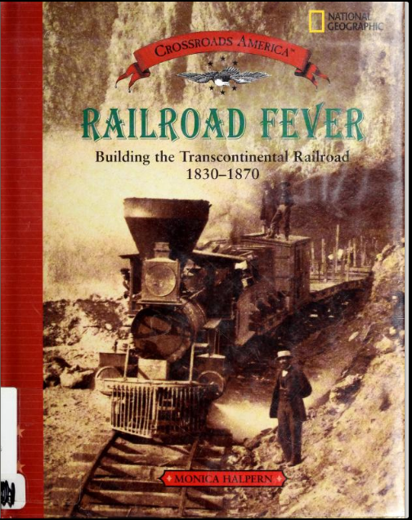
Railroad fever
Spring 1857 – Cincinnati Enquirer reported ‘railroad fever’.
‘By late summer that optimism was shattered, the value of western land fell and the speculative railroad securities fell with it […] by late July a substantial depreciation in trunk-line stocks occurred.’ (Calomiris & Schweikart, 1991, p.811)
Domino effect.
Notes:
Railroad fever was the culprit, as reported in the Cincinnati Enquirer and elsewhere. Essentially, this was what we might call a market bubble of boundless confidence in the future of the Southern Illinois Railroad, leading to much financial speculation and the buying up of land for expected new railroad routes. Of course, railway speculation was a feature of the age, claiming many victims beyond this one newspaper. [CLICK] Like all such bubbles, it soon burst, as Calomiris & Schweikart note. Within weeks, there was substantial depreciation in stock prices. [CLICK]
This led to a domino effect resulting in bank suspensions, as we saw on the previous slide. The panic was over before the end of the calendar year, so it is not immediately apparent why this would be the reason for shareholders backing out. But timing was critical – news of the panic would reach London at a vital time in the preparations for the new paper. And, let’s not forget, this was to be the Illustrated News of the WORLD.

Slide 8
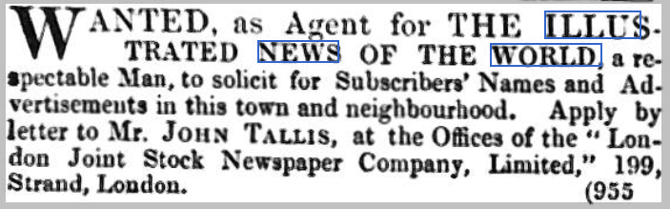
Transatlantic networks
During the 1840s, John Tallis had invested considerable time in the United States.
Established agencies in six cities from which to sell his publications.
This network, with all his other business assets, was transferred to the London Printing and Publishing Company.
Notes:
Before setting up on his own, John Tallis made a long business trip to the United States in the 1840s, [CLICK] where he established a series of agencies to handle his publications in New York, Baltimore, Boston, Cincinnati, Philadelphia and Rochester – cities right in the midst of the financial panic. It is reasonable to infer that Tallis now intended to use these American agencies to sell the INOW in the United States. If that potential market was thought to be under threat after the panic, that might be the reason for shareholders withdrawing support. [CLICK]
Being denied access to the assets and networks of the company he founded forced Tallis to go it alone. He quite wealthy, with an income of £4-5,000 per annum and was, clearly, committed to the venture, purchasing a new Hoe rotary printing press for £4,200. It’s notable, however, that, as the paper was about to make its bow, he was advertising widely for new agents to distribute it. [CLICK] Here’s one example of such an advertisement, taken from the Norwich Mercury on 30th January 1858. Note that it uses a different company name in this ad. In any case, the new publication did launch the following week, so let’s take a look at it.

Slide 9
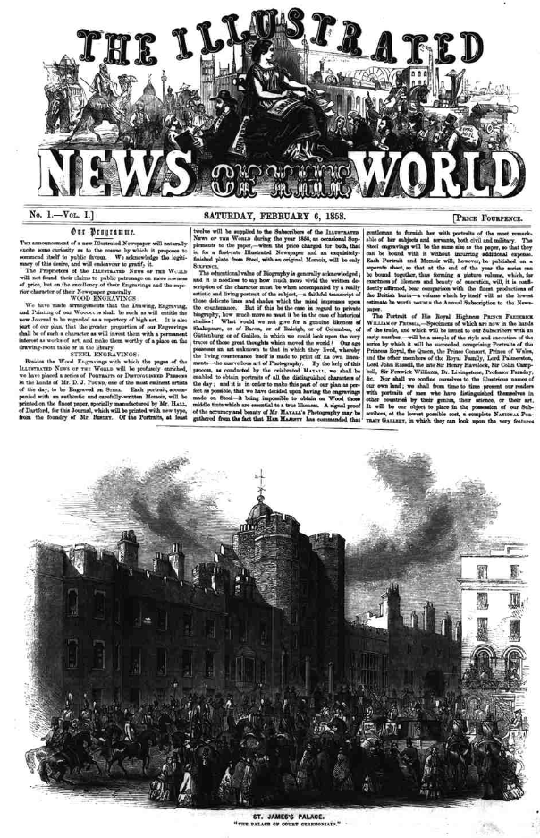
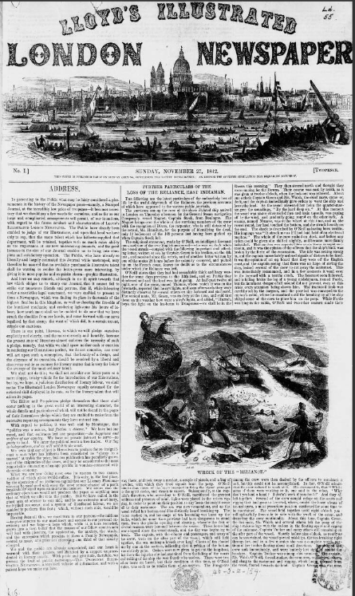
Direct rivals?
Notes:
If this first issue of the Illustrated News of the World seems to be in rather a familiar form, it may be due to being a close imitation of this – [CLICK] the established publication it was seeking to rival and perhaps displace.
Tallis’s paper was by no means the first or only pretender to the crown – [CLICK] Edward Lloyd also tried it on, very soon after the launch of the ILN, in 1842. Lloyds Weekly – for various reasons – dropped this form and continued successfully as a more conventional newspaper, whereas the Illustrated News of the World retained its form until its end.
The new publication is actually rather clever in that it’s superficially similar in terms of organisation of space, in the balance between text and image…

Slide 10
Notes:
Yet, at the same time, the more varied typefaces making up the title; and the masthead graphics juxtaposing metropolitan and imperial motifs with exotic foreign images strongly suggests its wider ambitions. Interestingly, the Illustrated London News made no reference to the arrival of this competitor, neither did Ingram make any moves to counter or purchase it.

Slide 11
Mixed reception
The arrival of the INOW did not go unnoticed…
A powerful rival, and we must say, rather close imitation of the Illustrated London News has just been launched […] judging from its prospectus, its engravings, its letter press and its price, we feel convinced it will become a popular favourite.
[REVIEW of ‘The Illustrated News of the World’, The Leicester Guardian
20/02/1858, p.3
‘if the forthcoming weekly publication be one half as beautiful and promising as this specimen, it will be a work rich in art and admirable in execution […] Altogether it is the most promising specimen of a first number we have ever seen.’ [‘The Illustrated News of the World’, The Sun, 03/02/1858, p.6]
The new venture is called the Illustrated News of the World, and of its literary or pictorial merits I am not about to speak; but one number has been issued, and we have no right to judge from a first attempt. What I would comment most strongly upon is the unfair manner in which the proprietors of the new journal have striven to take advantage of the fame already raised by their predecessors.
‘From our London Correspondent’, The Inverness Courier, 11/02/1858, p. 4
Notes:
Whilst Ingram’s paper ignored the new arrival, many others took notice. [CLICK]
The Sun, reviewing an advance copy, was very positive, praising ‘the most promising specimen…we have ever seen’. [CLICK] Conversely, the Inverness Courier expressed its outrage at the ‘unfair manner’ of the imitation. [CLICK] Somewhere in the middle was this review in the Leicester Guardian which noted the similarity whilst opining that it was a ‘powerful rival’ likely to become ‘a popular favourite’. So, despite the circumstances of its genesis, there was an expectation that the new title would become established as a rival to the Illustrated London News. To be more than a mere imitator, though, it needed something distinct – and here Tallis could draw on his contacts in the world of illustration…

Slide 12
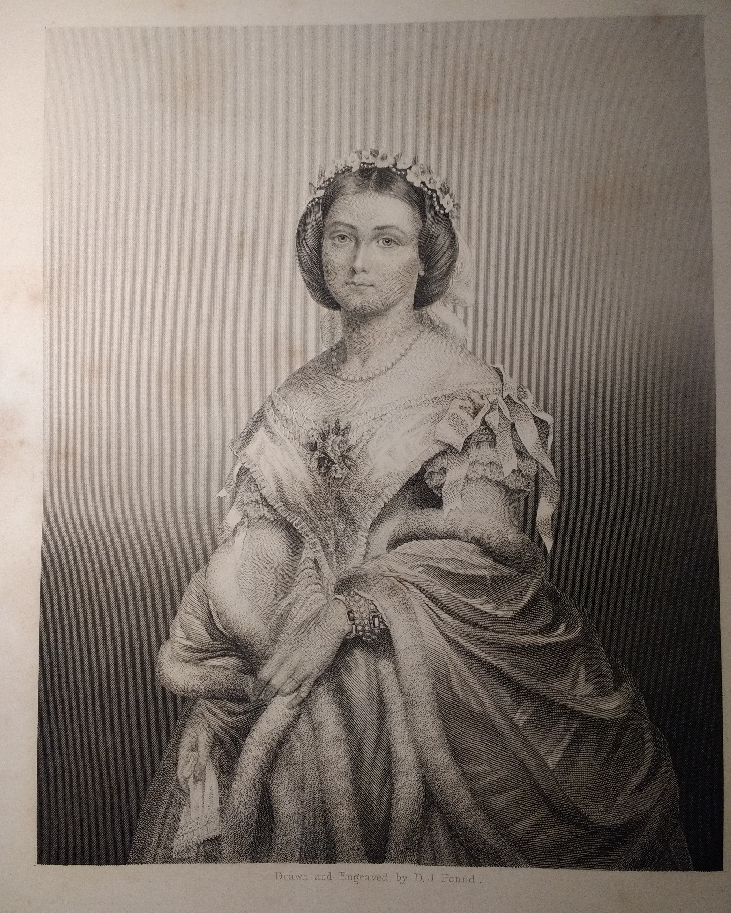
Unique selling point
‘And Drawing Room Gallery of Eminent Personages’.
Collectible engraved plates, separately or in bound volumes.
For posterity.
But costly.
Notes:
To offer his subscribers an innovation in the form of steel engravings, reproducing photographic portraits – this one, the first, is of Princess Victoria, to mark her marriage to Prince Frederick William of Prussia which had recently taken place on 25th January 1858. At the time, this was the highest quality mass reproduction available. The engraver was Daniel Pound and the photographer John Mayall of Regent Street.
This offering was reflected in the subtitle [CLICK] soon appearing on the paper’s masthead, ‘and drawing room gallery of eminent personages’. Available separately or in volumes for subscription (with the newspaper thrown in!) these steel-engraved portraits were certainly a quality addition, but reproduction of this level of quality was expensive.

Slide 13
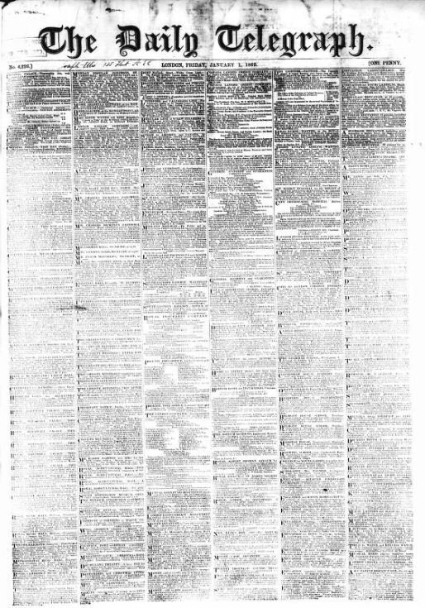
Financial challenges and solutions
Paper supply terms – Spalding & Hodge.
Arrangement to print Daily Telegraph
brought in £100 p.w. for a while
Idea for part-printed provincial papers
Mortgaged copyright of INOW to
Spalding & Hodge.
Bankruptcy (1861)
INOW continued. Quality maintained.
Notes:
Tallis hit one immediate problem around launch time: the supply of paper. The original supply agreement had been made between the London Printing and Publishing Company and Spalding & Hodge, who extended credit secured on Tallis’s shares in the company. As his shares were now suspended, he was technically indebted to Spalding & Hodge. His only tangible asset, the Hoe printing press that he must have purchased himself, was sold to them to settle matters, so that Tallis now had to rent back the press he had just bought. [CLICK] Printing the Telegraph brought much needed income while it lasted – but in early 1860 they imported their own Hoe press, (from the US, of course); a crippling blow. [CLICK] Tallis then sought to work with provincial newspaper proprietors to supply part-printed sheets to be adapted for local papers. This was an idea very much of its time – but needed capital. [CLICK] To raise it, he mortgaged the copyright of INOW to Spalding & Hodge to raise funds – but they demanded settlement promptly and, when Tallis couldn’t pay, they sold it on! Tallis was ruined and [CLICK] filed for bankruptcy in 1861. [CLICK] The paper continued until 1863, unusually maintaining its illustrative and textual quality throughout. Latterly, it seems to have been published by the very company that Tallis founded for the purpose.

Slide 14
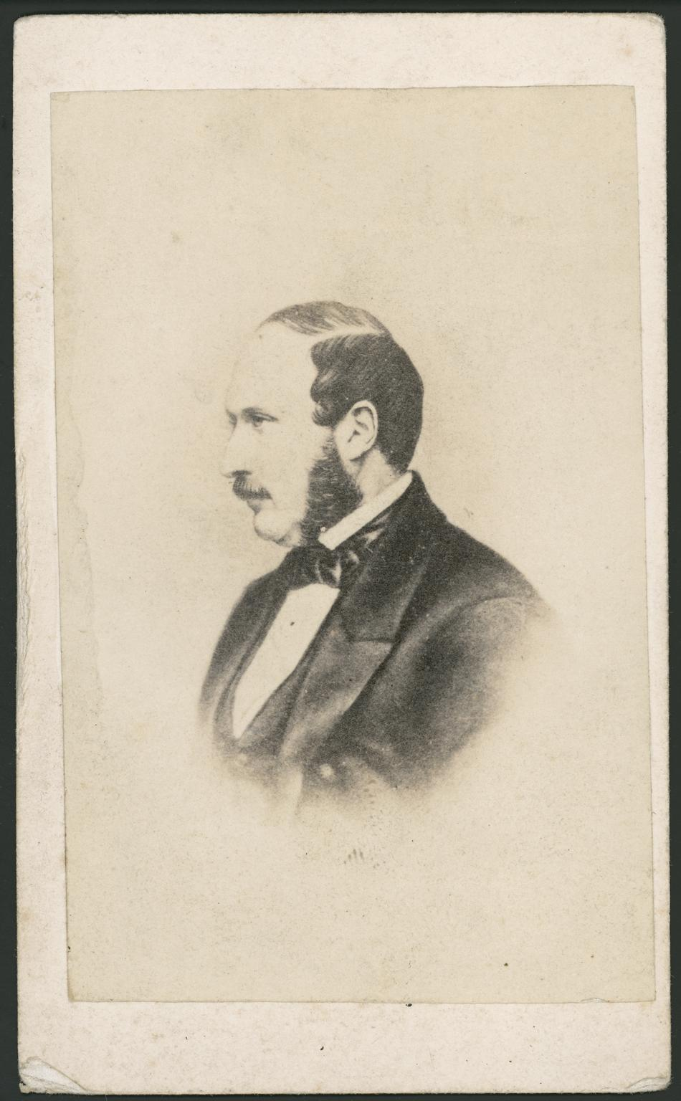
The final straw
Final publisher, James Ritchie, was to blame the American (Civil) war for the ‘falling off of sales’.
Improvements in photographic reproduction.
Cartes de visite portraits – example alongside.
The INOW ceased publication without fanfare.
Notes:
Having continued until number 300, the INOW itself filed for bankruptcy in 1863. [CLICK] Its final publisher, James Ritchie, declared to the bankruptcy court that the ‘falling off of sales’ was due in part to the American (Civil) war. We know that a paper with the same title was available in the US from 1858 to at least 1861, as it has been catalogued by the Library of Congress – so it seems that, somehow, the paper did make it across the pond. If the American market was affected by the war, clearly the domestic market was now insufficient to keep the paper viable. [CLICK] Ritchie also suggested that recent developments in photographic reproduction affected sales. As it happens, tintype and ambrotype mass reproduction of photographic images for collection had been growing in popularity on both sides of the Atlantic. In America, top sellers were scenes from civil war battles, while in Britain, the popular form was small collectible portraits in [CLICK] the ‘carte de visite’ form, especially from 1860, after John Mayall had produced portraits of the royal family. [CLICK] Here is one of Prince Albert. So even at the end, there was a feeling that Transatlantic influence had impacted negatively on the INOW. [CLICK] The newspaper itself – as was so frequently the case – made no mention of its own demise.

Slide 15
What part did events in the USA play in the inow’’s fate?
How does this analysis help to problematize the assumption of failure?
Notes:
Returning to our research questions, I am struck by a number of ‘what if?s’ What if there hadn’t been a financial panic in America? What if the London Printing and Publishing Company’s shareholders had not withdrawn support? What if Spalding and Hodge had been more patient? What if the Daily Telegraph hadn’t purchased its own press when it did?
Whether the American financial panic of 1857 was the decisive factor that led to shareholders in the London Printing and Publishing Company denying Tallis access to the assets and networks he nurtured, we will never know; but the effect was that, ultimately, he could not make the paper pay. Against these obstacles, the fact that he launched it and kept it going long enough that it continued after him is a partial success. There is a further irony in that the Illustrated News of the World outlasted the man who inspired it; Herbert Ingram was to die in 1860, in a steamship collision whilst on a holiday in the United States. This was indeed an ill wind from the west that blew nobody involved, any good.

Slide 16
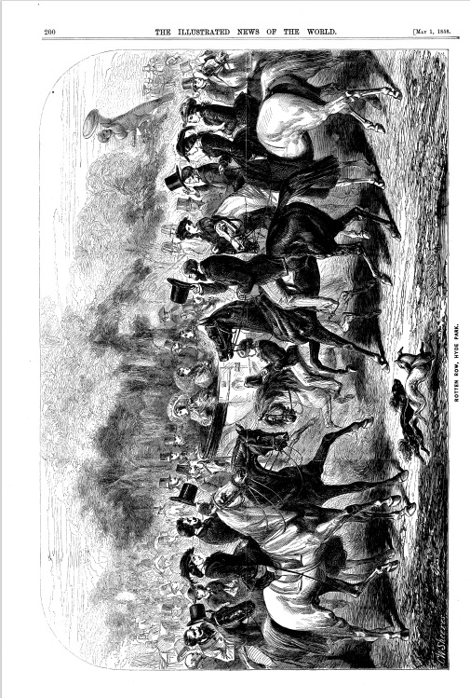
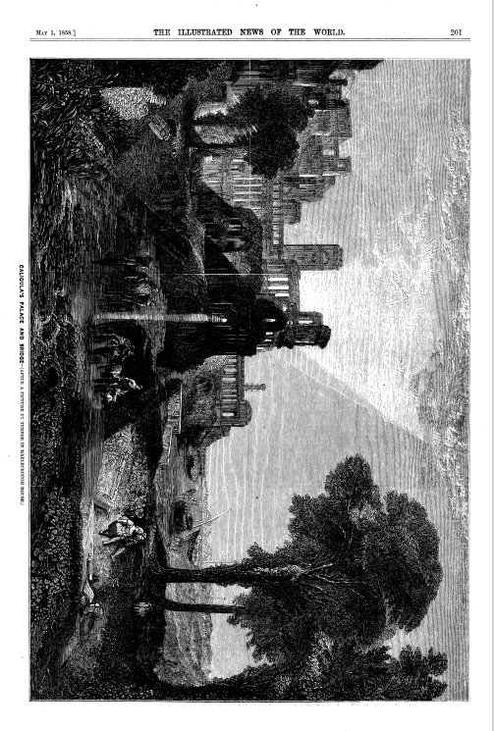
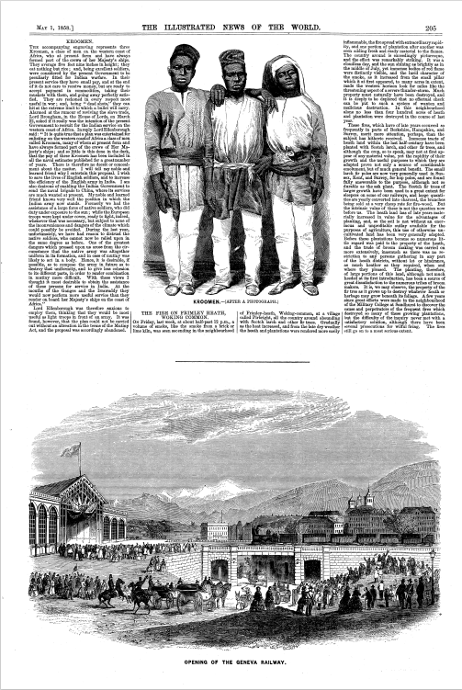
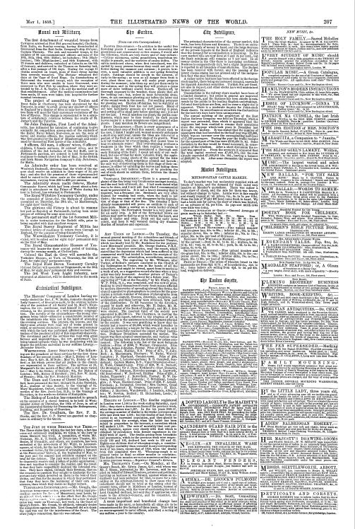
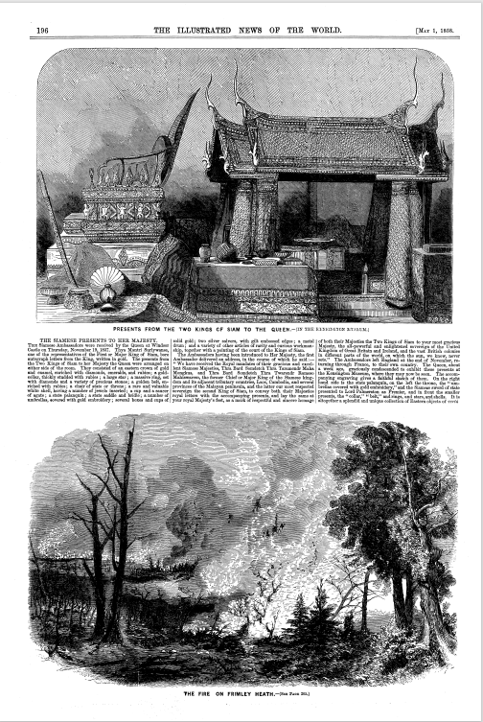
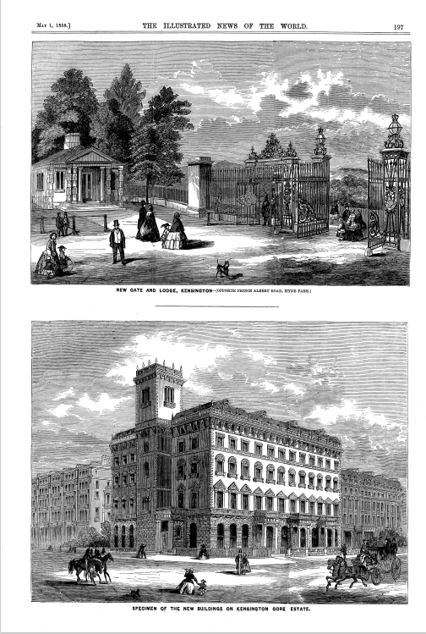
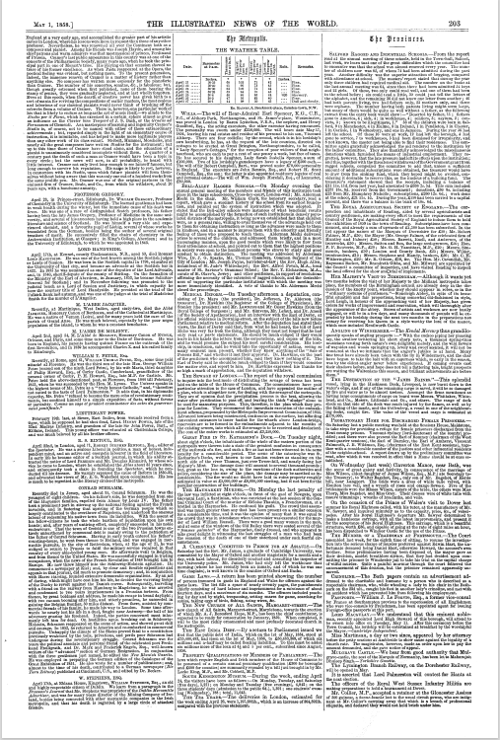
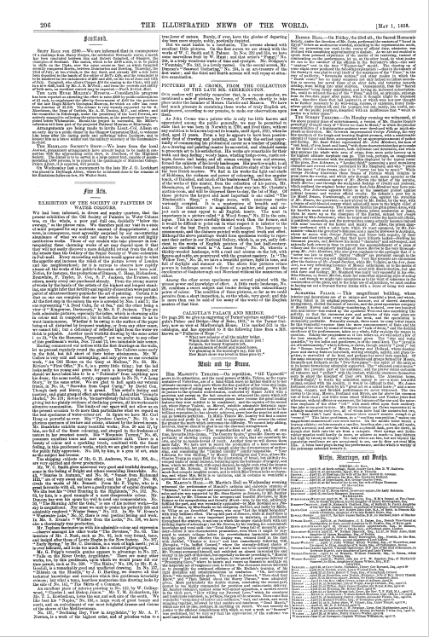
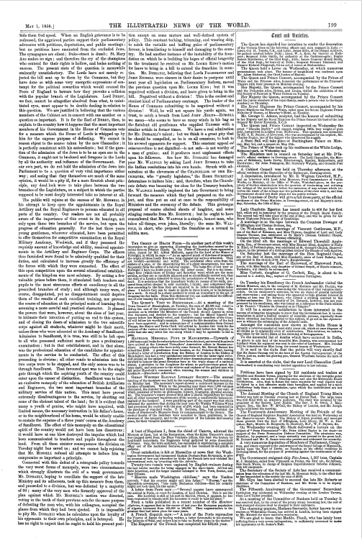
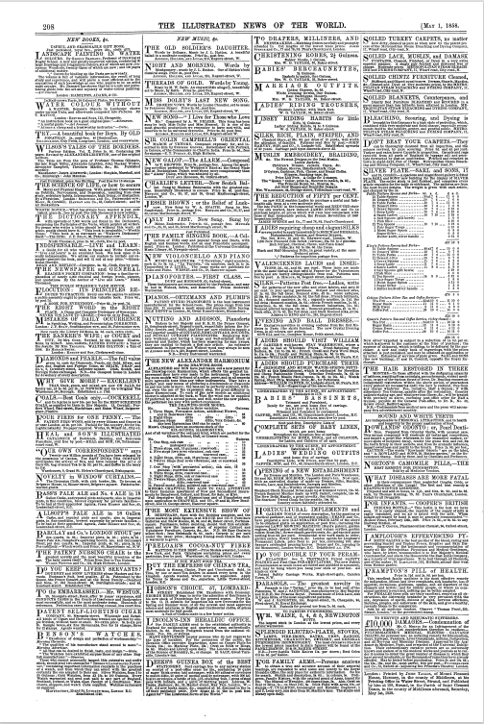
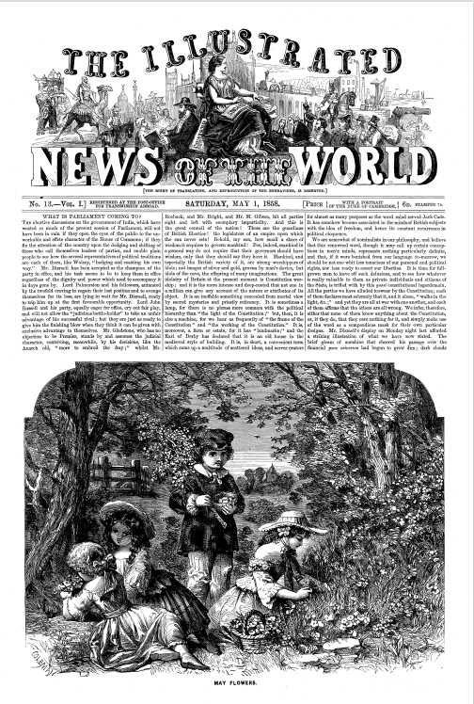
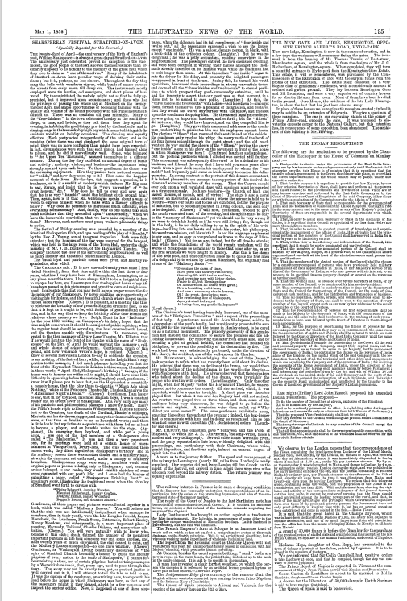
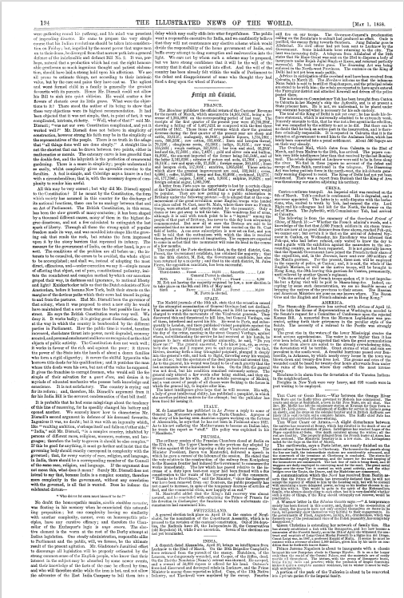
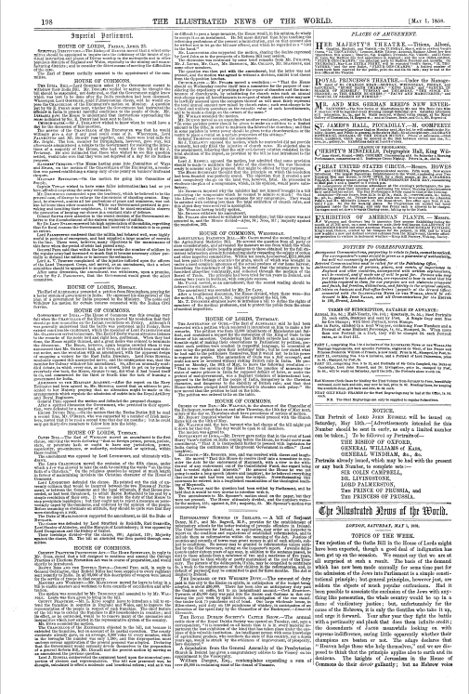
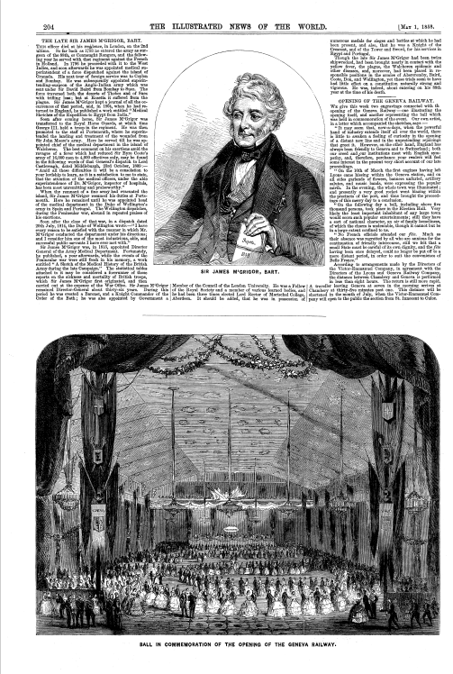
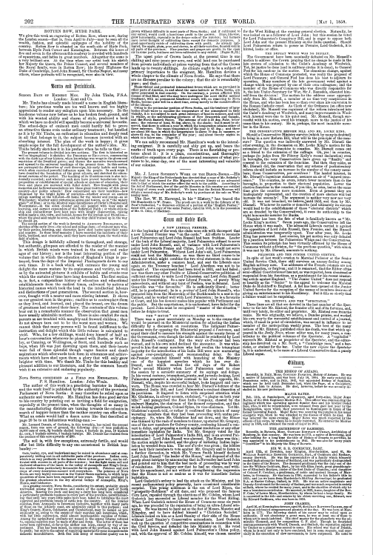
Notes:
Despite its short life, the Illustrated News of the World is a lavish, beautifully-produced body of work. The number and quality of illustrations and the clarity of the print made it the equal at least of the paper it sought to rival. It covered the expected topics of a serious newspaper, offering home, foreign and parliamentary news, police reports and arts reviews, whilst giving half of its space to its impressive woodcuts offering scenes from the wider world. Its arrival was broadly welcomed and it was expected to prove a worthy adversary to Ingram’s title.
Was it, then, a failure? In terms of not supplanting the Illustrated London News, yes. But Tallis wanted it to be more than just a typical newspaper. One of its stated aims was to provide something of lasting value for the historian, which I think it does both in its journalism as a contemporary record; and as an exemplar of developments in the form of the post-repeal illustrated press. Emblematic of mid-century confidence in progress, of using new technologies to capture and catalogue the age, there is, I contend, a case to argue for its success despite its short life. The steel engravings in particular produced mass-market published images of a quality that wouldn’t be reached again until well into the twentieth century. For me, the Illustrated News of the World – and Tallis – deserved a better fate.

Slide 17


Thank you
Website: https://matthewstephens.org.uk
@C19thnewshound
@c19thnewshound.bsky.social
Matthew Stephens
Notes:
Thank you.

